Slide 1
This activity has been supported by a grant from Roche Products Ltd
How are medicines made?
'Presenter 1'
'Presenter 2'
Notes:
Briefly Introduce myself

Slide 2
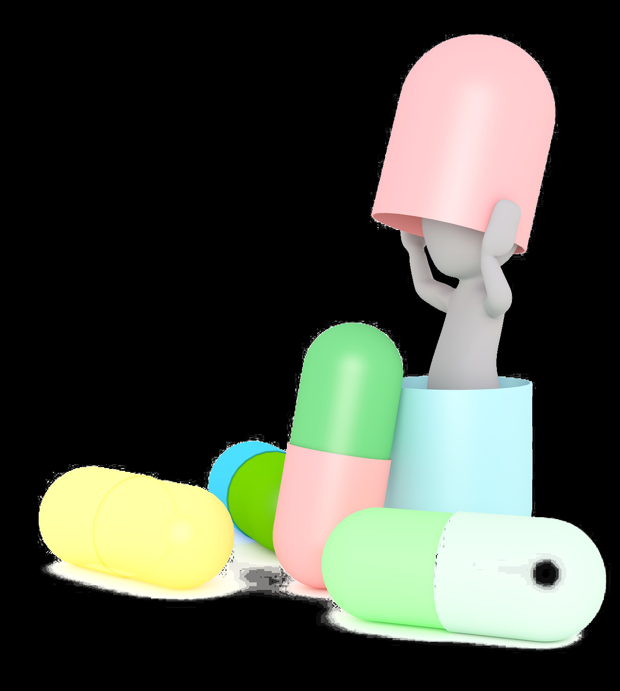
What are medicines?
Medicines (drugs):
Change the way our bodies work
Help our bodies to fight off illness
Help us stop getting ill in the first place
Make us feel better
Notes:
Briefly Introduce myself

Slide 3
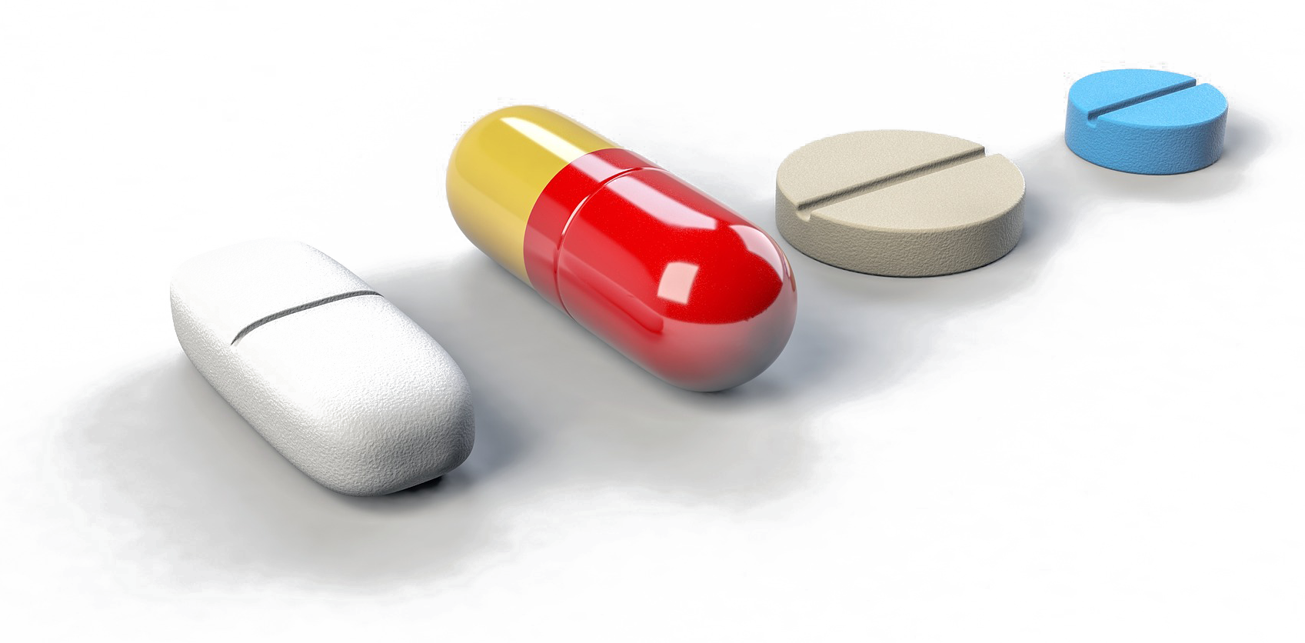
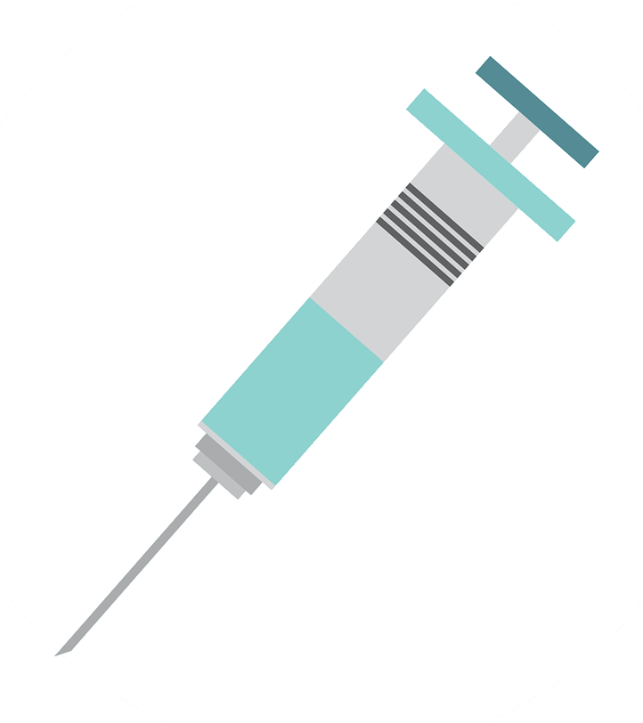
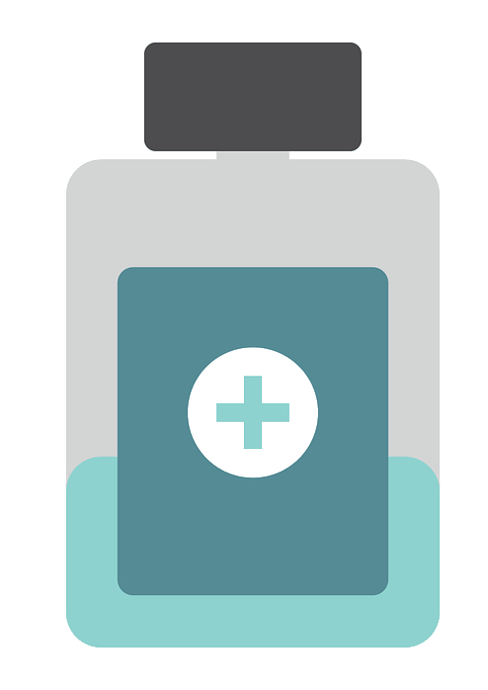
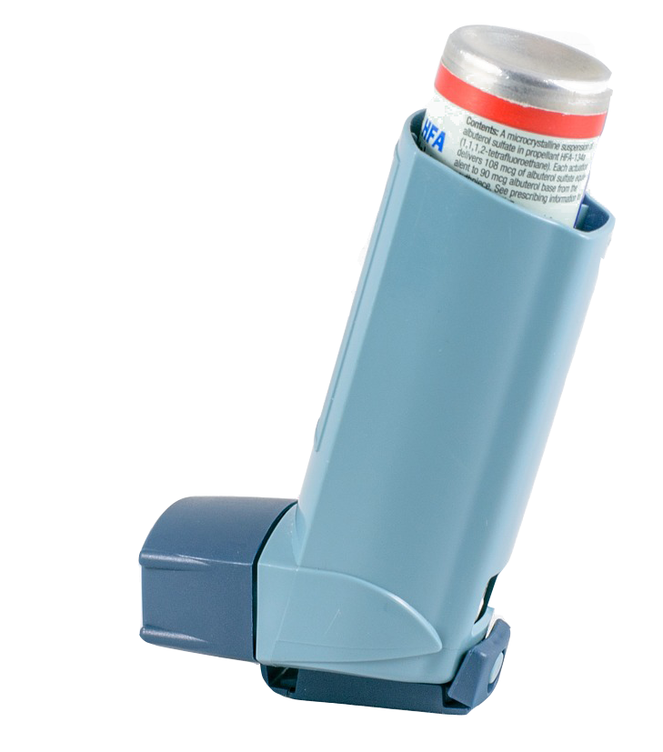
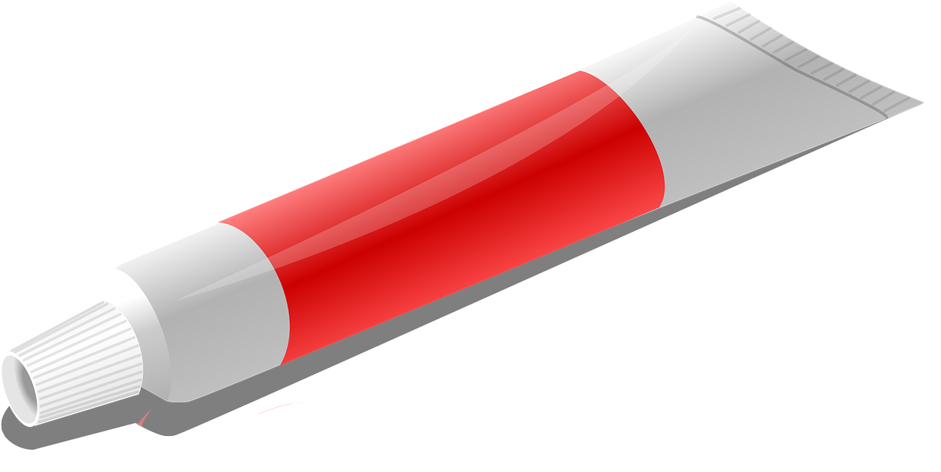
How do we take medicines?
Tablets
Injection
Drink
Inhaler
Cream
Notes:
Briefly Introduce myself

Slide 4
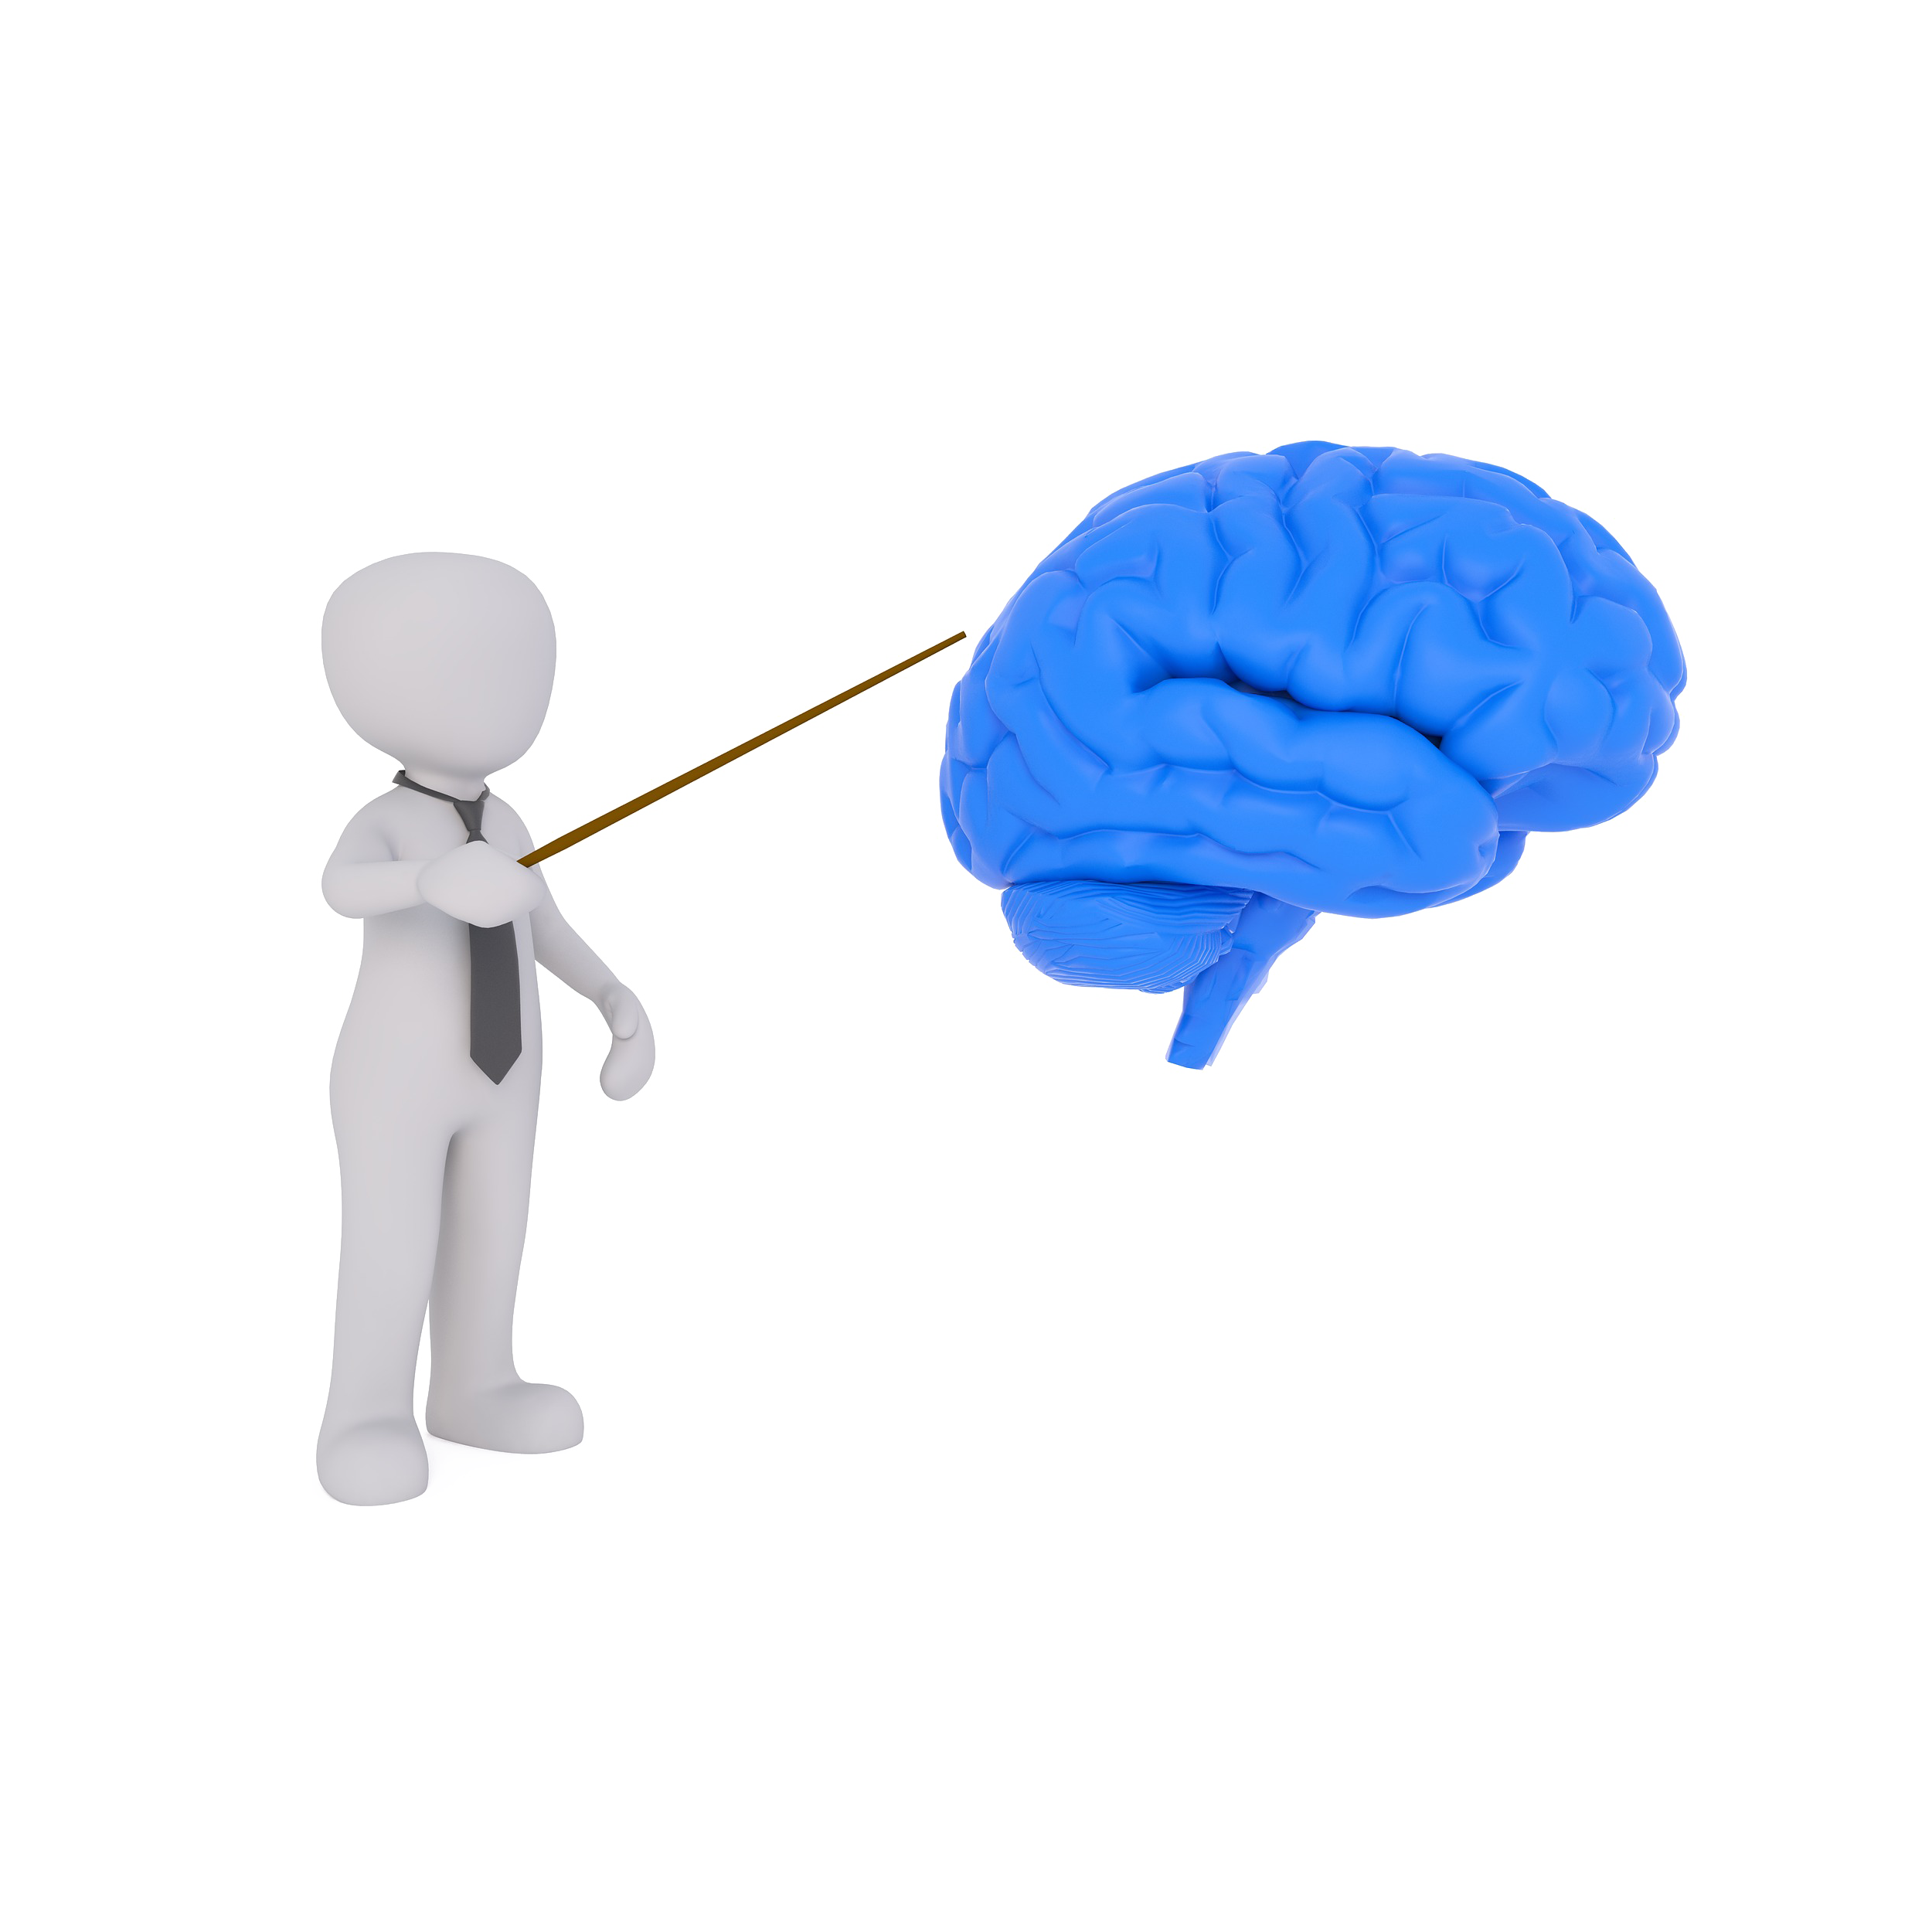
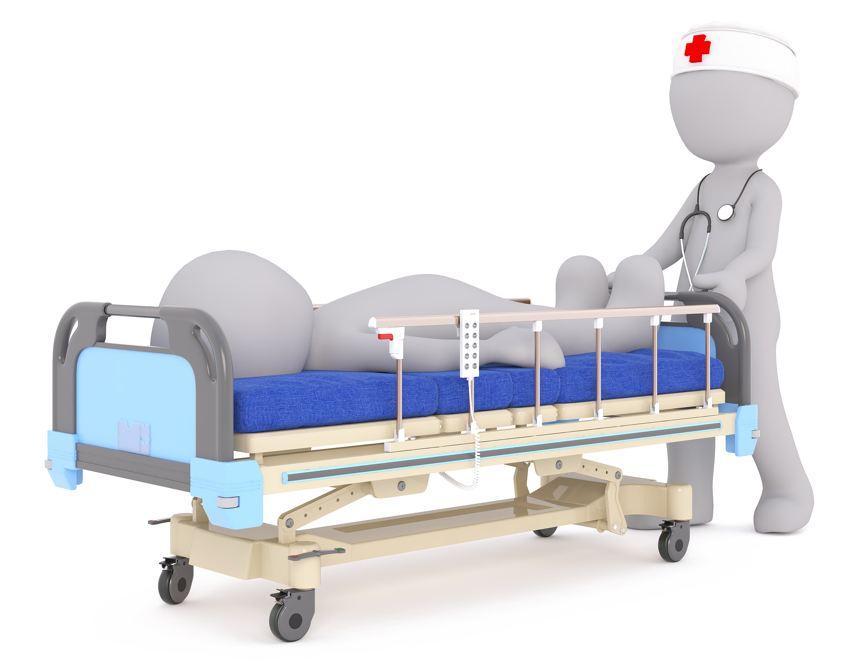
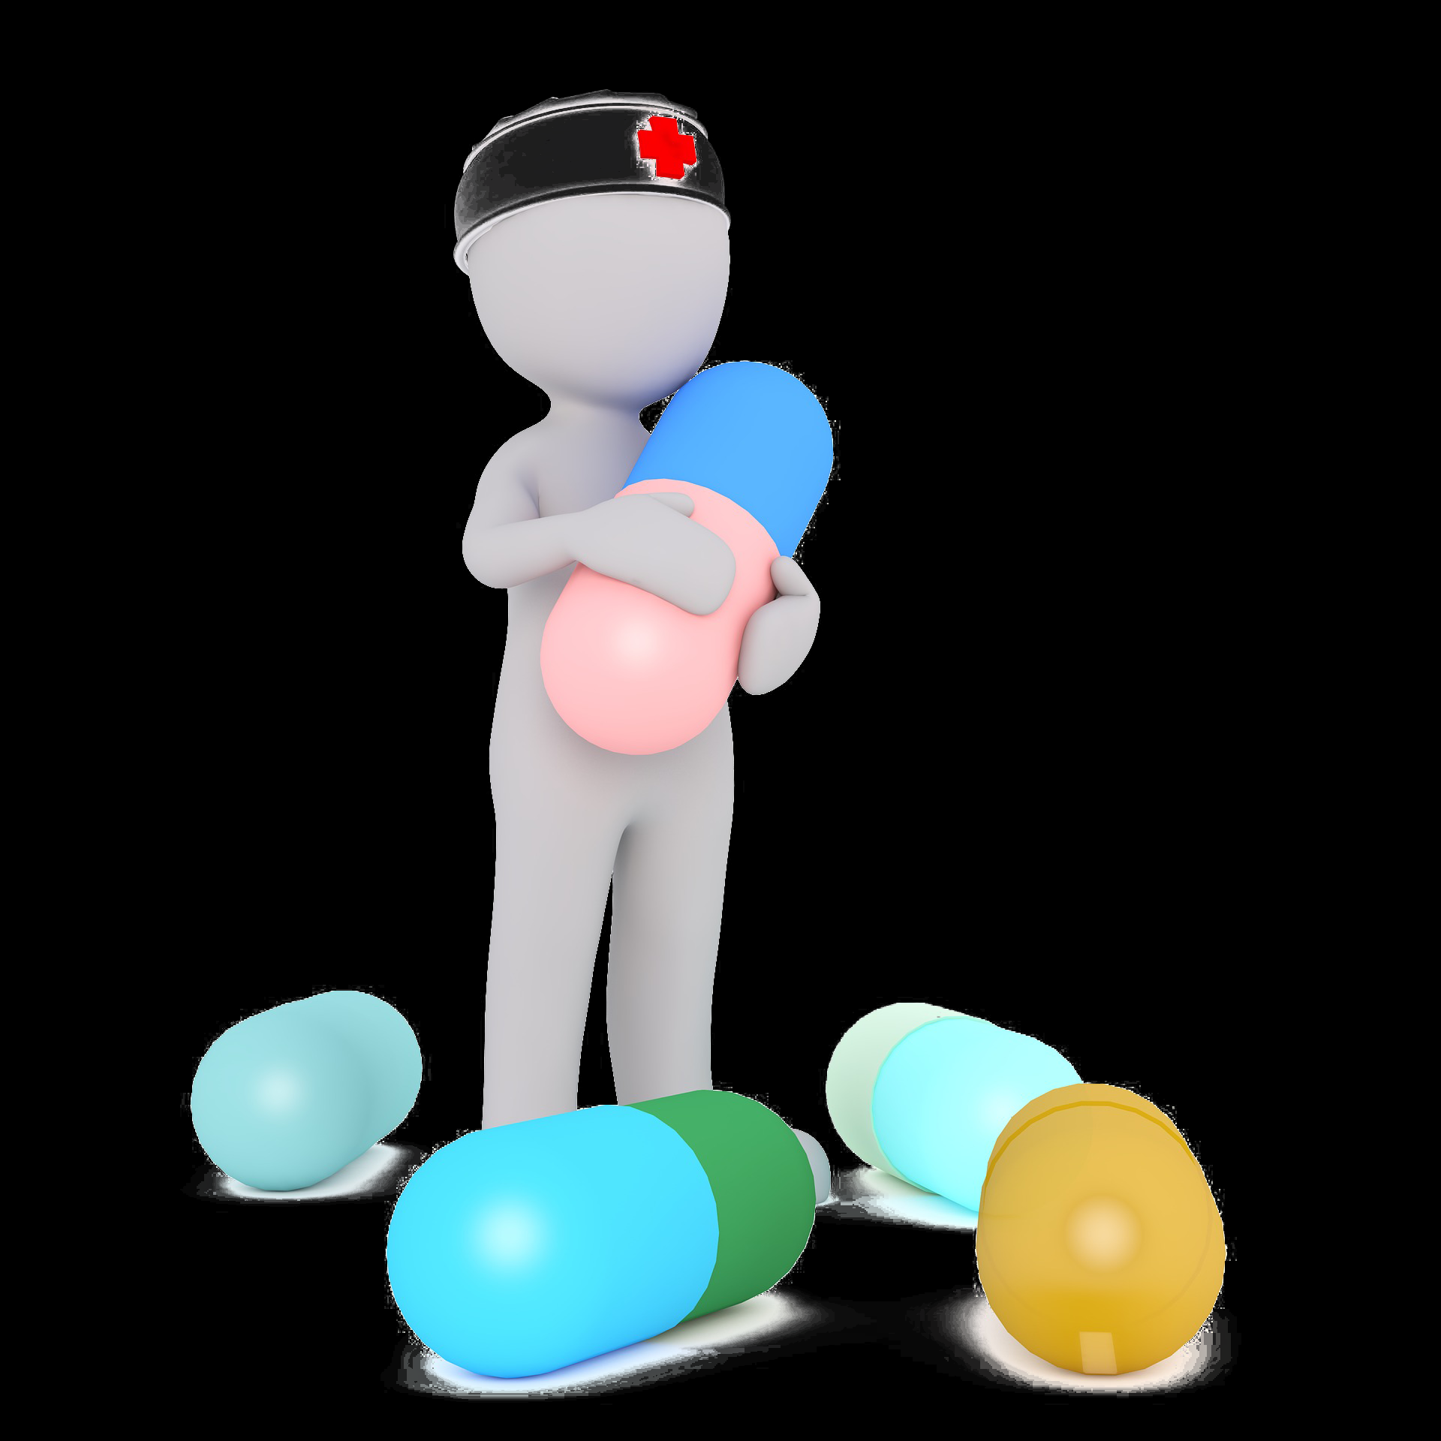
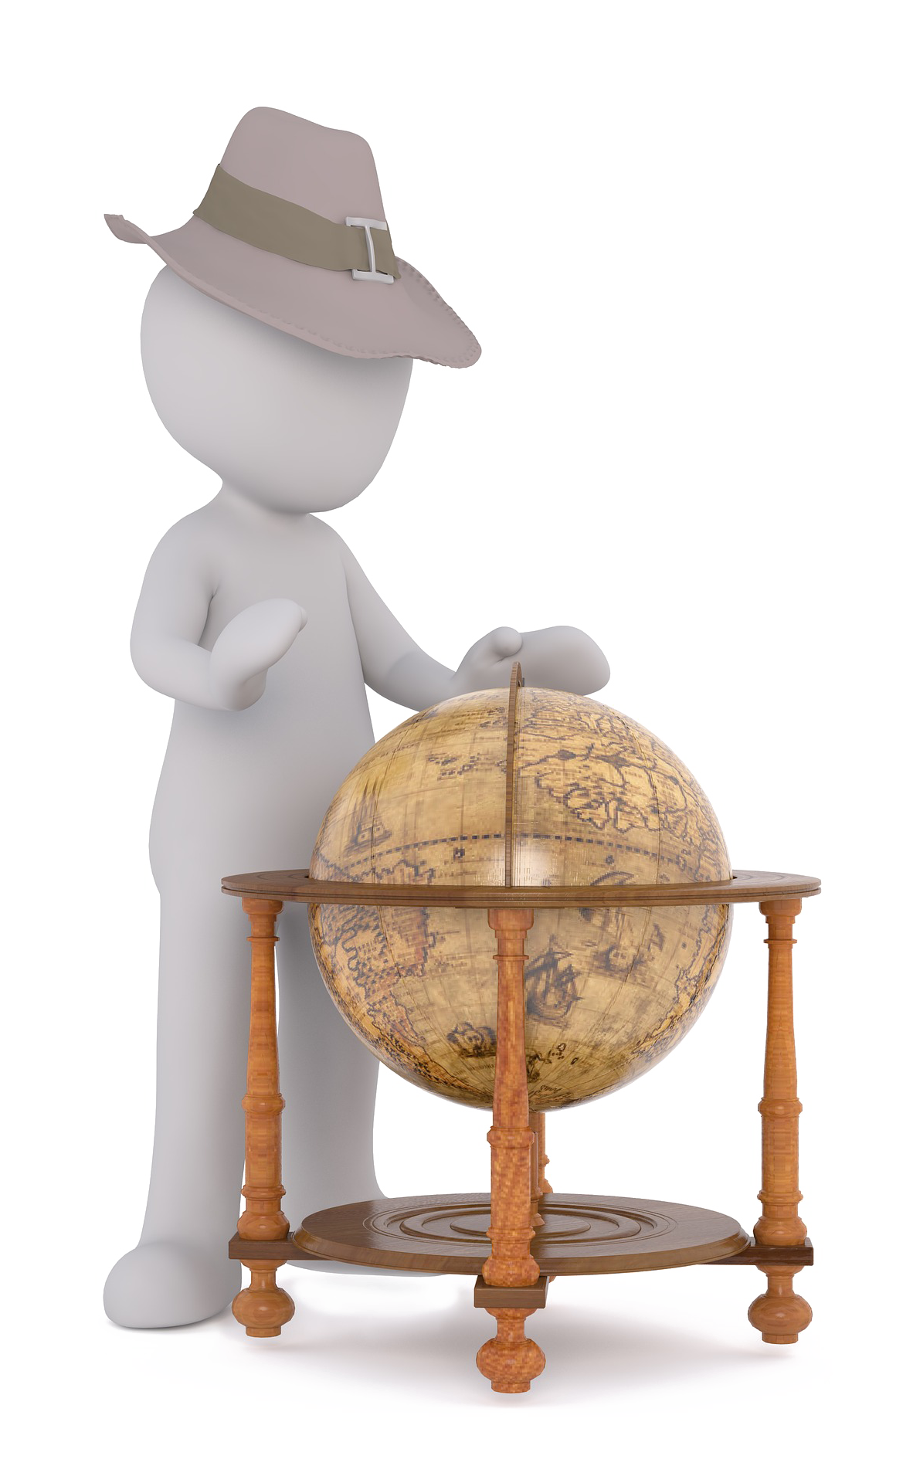
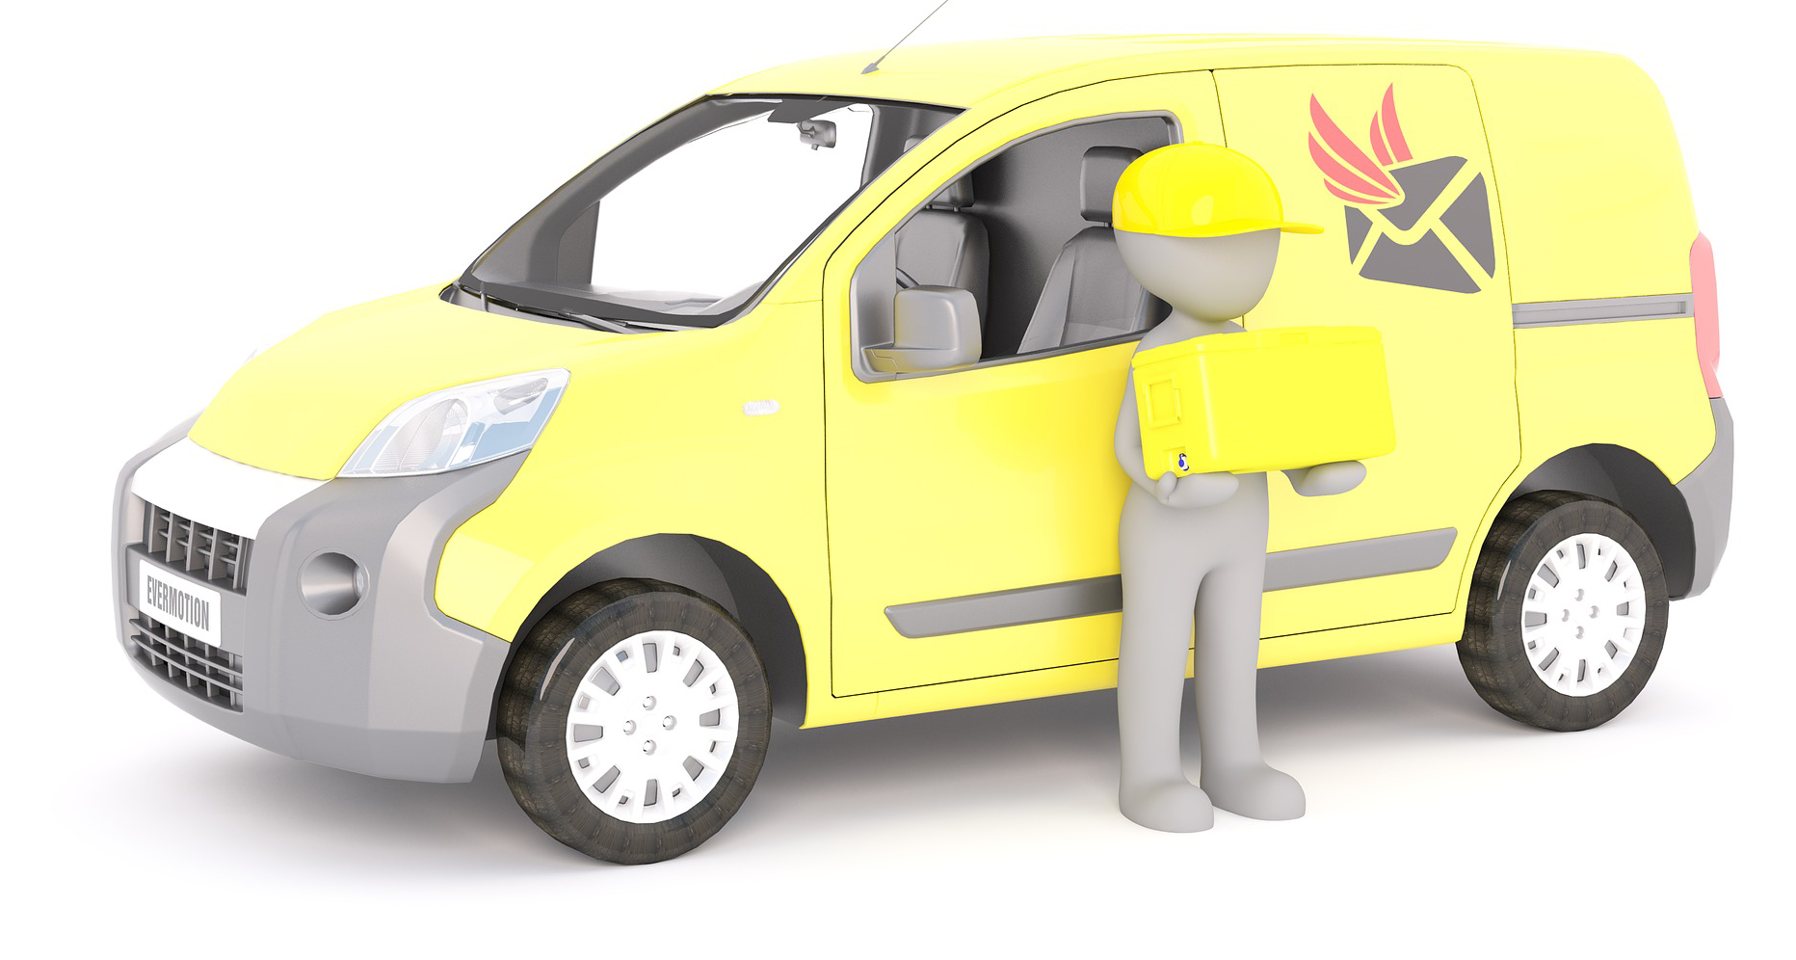
Where do medicines come from?
Patient
Testing Team
Scientist
Pharmacist
Doctor
Lorry Driver
Factory Worker
Explorer
Notes:
Briefly Introduce myself

Slide 5
Where do medicines come from?
1. Patient
Why are they ill?
Notes:
Briefly Introduce myself

Slide 6
Where do medicines come from?
Patient
Testing Team
Scientist
Pharmacist
1
Doctor
Lorry Driver
Factory Worker
Explorer
Notes:
Briefly Introduce myself

Slide 7
Where do medicines come from?
2. Doctor
What does the doctor wear?
Doctor may ask:
Why have you come in today?
What are your symptoms?
How long have you had them?
Doctor may give you a prescription for medicine
Notes:
Briefly Introduce myself

Slide 8
Where do medicines come from?
Patient
Testing Team
Scientist
Pharmacist
1
Doctor
Lorry Driver
Factory Worker
Explorer
2
Notes:
Briefly Introduce myself

Slide 9
Where do medicines come from?
3. Pharmacist
What does the pharmacist wear?
What does the pharmacist do?
Takes the prescription and finds the medicine
Advises on when to take the medicine and how much (dose)
Notes:
Briefly Introduce myself

Slide 10
Where do medicines come from?
Patient
Testing Team
Scientist
Pharmacist
1
3
Doctor
Lorry Driver
Factory Worker
Explorer
2
Notes:
Briefly Introduce myself

Slide 11
Where do medicines come from?
4. Lorry Driver
What does the Lorry Driver wear?
What does the Lorry Driver do?
Delivers the medicine to the pharmacist
Notes:
Briefly Introduce myself

Slide 12
Where do medicines come from?
Patient
Testing Team
Scientist
Pharmacist
1
3
Doctor
Lorry Driver
Factory Worker
Explorer
2
4
Notes:
Briefly Introduce myself

Slide 13
Where do medicines come from?
5. Factory Worker
What does the Factory Worker wear?
What does the Factory Worker do?
Makes the medicine in large amounts
Notes:
Briefly Introduce myself

Slide 14
Where do medicines come from?
Patient
Testing Team
Scientist
Pharmacist
1
3
Doctor
Lorry Driver
Factory Worker
Explorer
2
4
5
Notes:
Briefly Introduce myself

Slide 15
Where do medicines come from?
6. Testing Team /
Clinical Trials
What do the testing team wear?
What do the testing team do?
Make sure the medicine is safe for humans
Make sure the medicine works
Work out how much medicine is needed and when it should be taken
Notes:
Briefly Introduce myself

Slide 16
Where do medicines come from?
Patient
Testing Team
Scientist
Pharmacist
1
6
3
Doctor
Lorry Driver
Factory Worker
Explorer
2
4
5
Notes:
Briefly Introduce myself

Slide 17
Where do medicines come from?
7. Scientist
What do scientists wear?
What do scientists do?
Investigate what causes diseases
Investigate what causes pain
Make medicines to stop diseases and pain
Notes:
Briefly Introduce myself

Slide 18
Where do medicines come from?
Patient
Testing Team
Scientist
Pharmacist
1
6
7
3
Doctor
Lorry Driver
Factory Worker
Explorer
2
4
5
Notes:
Briefly Introduce myself

Slide 19
Where do medicines come from?
8. Research explorer
What does a research explorer wear?
What do research explorers do?
Find biological samples that could be turned into medicines
Notes:
Briefly Introduce myself

Slide 20
Where do medicines come from?
Patient
Testing Team
Scientist
Pharmacist
1
6
7
3
Doctor
Lorry Driver
Factory Worker
Explorer
2
4
5
8
Notes:
Briefly Introduce myself

