Slide 1




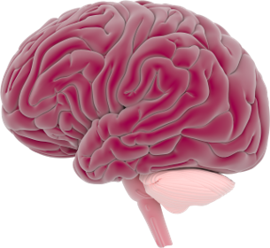
This activity has been supported
by a grant from Roche Products Ltd
Biomedical Science Outreach
The Brain & Nervous System
Lydia Bown
BNA Outreach Ambassador
Elena Toma
BNA Outreach Ambassador

Slide 2
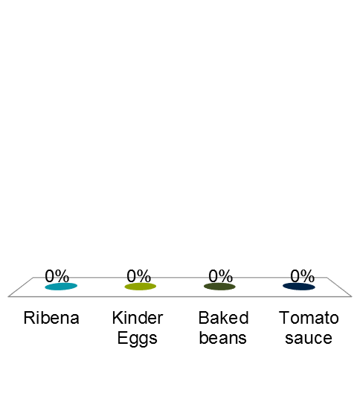
What would you feel if someone stuck a finger into your brain and waggled it about?
Unbearable agony – the worst pain in the world.
You'd feel hot and cold shivers all over your body.
Nothing because the brain can’t feel touch.
You would feel dizzy and then you would faint.

Slide 3
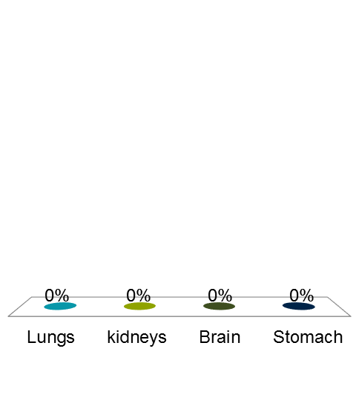
How much of your brain is water?
About 5%
About 80%
About 32%
About 1%

Slide 4
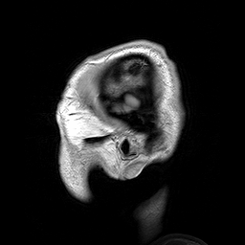
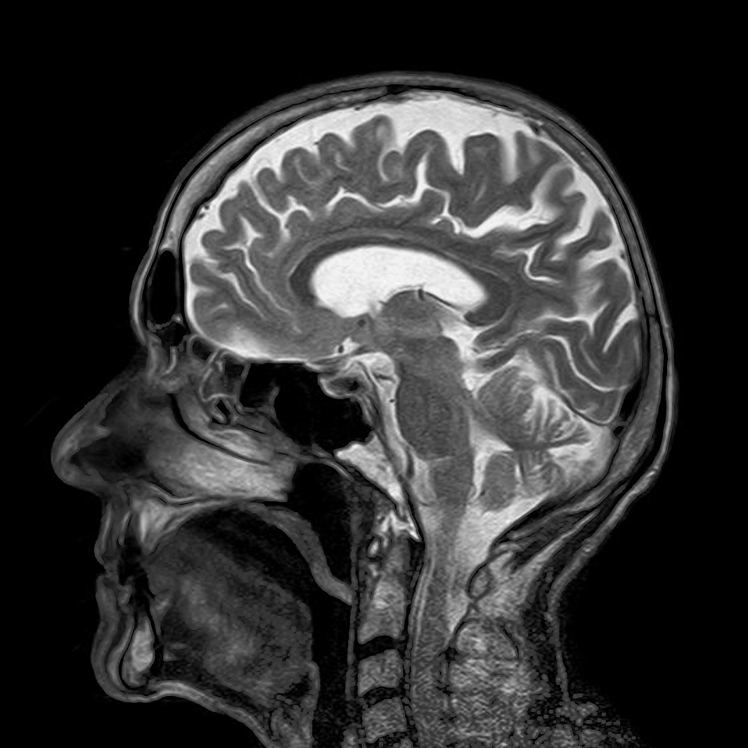
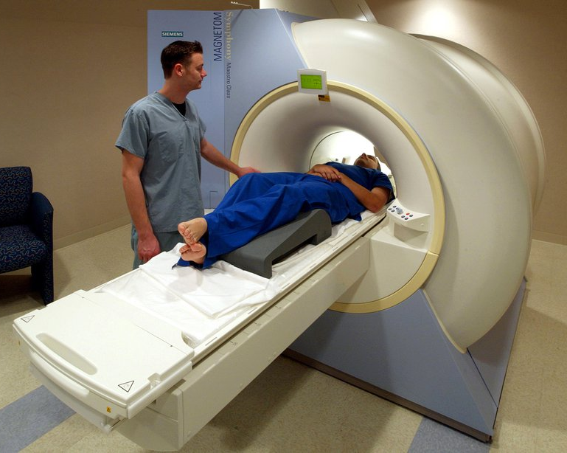
Brain Scanner

Slide 5
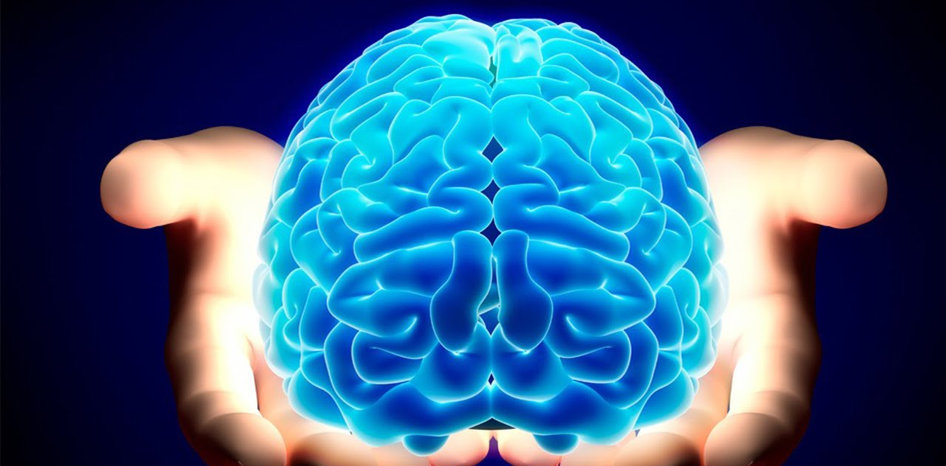
The Brain - what does it do?
Notes:
Ask the children what they think the brain is for.
What is the brain?
The brain is the control centre for your body and it sits in your skull at the top of your spinal cord.
The brain has three main parts.
The cerebellum (say se-re-bell-um).
The cerebrum (say se-re-brum), which has two parts, the left and right cerebral hemispheres, (say se-re-brell hem-iss-fears).
The brain stem, that controls a lot of the 'automatic' actions of your body such as breathing and heart beat, and links the brain to the spinal cord and the rest of the body.
Your brain is wrapped in 3 layers of tissue and floats in a special shock-proof fluid to stop it from getting bumped on the inside of your skull as your body moves around.
What the brain does
Your brain is more powerful, more complex and more clever than any computer ever built.
It is constantly dealing with hundreds of messages from the world around you, and from your body, and telling your body what to do.
It gets the messages from your senses - seeing, hearing, tasting, smelling, touching and moving. The messages travel from nerve cells all over the body. They travel along nerve fibres to nerve cells in the brain.
Looking after your brain
Your brain is protected inside your skull and is cushioned by cerebral-spinal fuild (se-re-bro-spi-nal) but could still be damaged if your head is hit or bumps into something hard.say
Always wear a helmet if you are riding a bike, scooter or skate board.
Always wear a helmet for sports where you could be hit or fall, eg baseball or horse-riding .
Never dive into water unless you know how deep it is. (Your brain should let you know that this is not a smart thing to do.)
Listen to that 'voice' inside you - you know what I mean, the one that says 'This is not a good idea!'
Apart from making sure that you don't injure your brain, you can also make sure that you help your brain by:
Eating healthy food like fish and fresh vegetables.
Exercising your brain by learning new things and trying to remember them.
Getting plenty of sleep.

Slide 6
Sustains life
Memories
Thoughts
Personality
Pain
Decision making
Emotions

Slide 7

The brain is a bit like a control centre

Slide 8

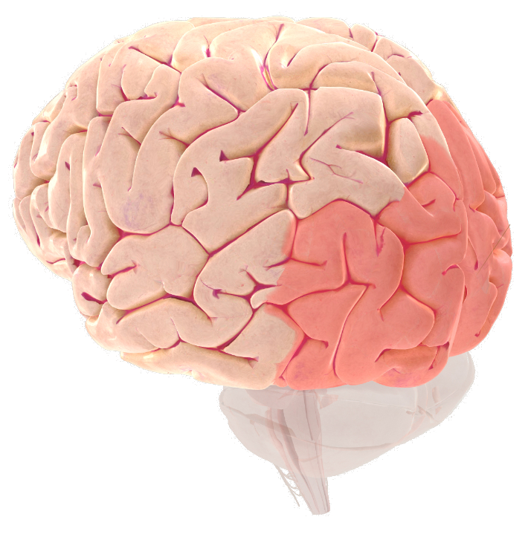
Vision
Front
Back
Copyright © Society for Neuroscience (2017)

Slide 9
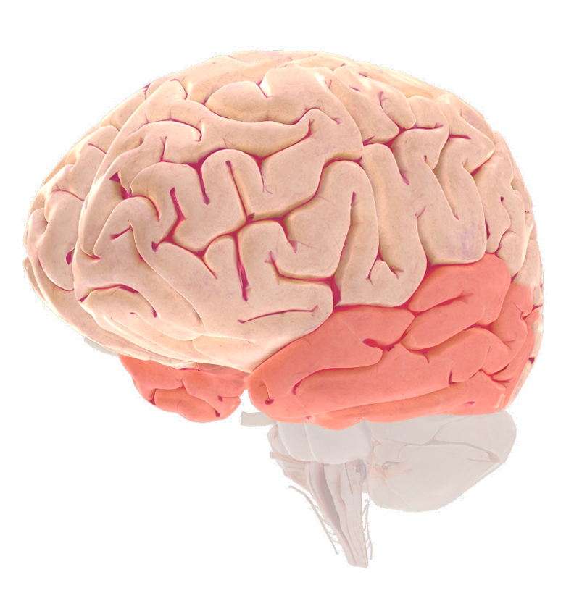

Hearing
Back
Front
Copyright © Society for Neuroscience (2017)

Slide 10
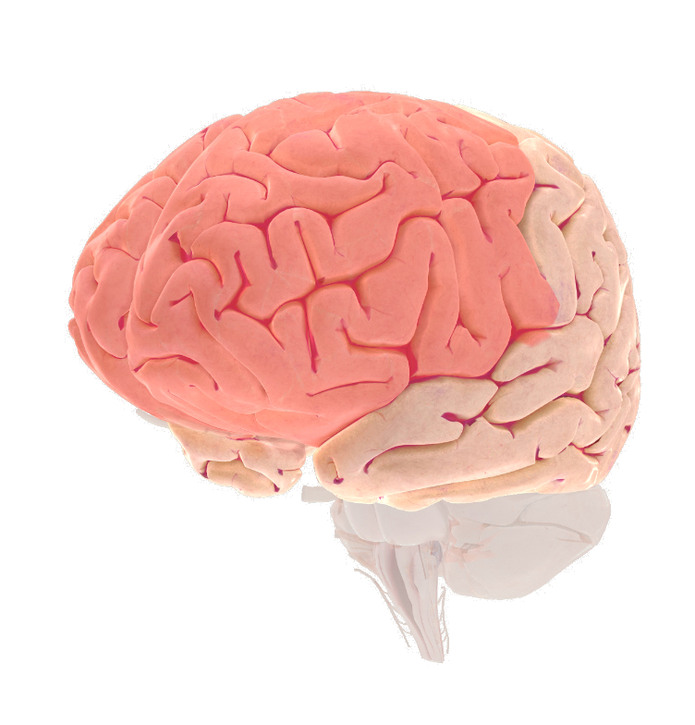

Decision-making
Front
Back
Copyright © Society for Neuroscience (2017)

Slide 11
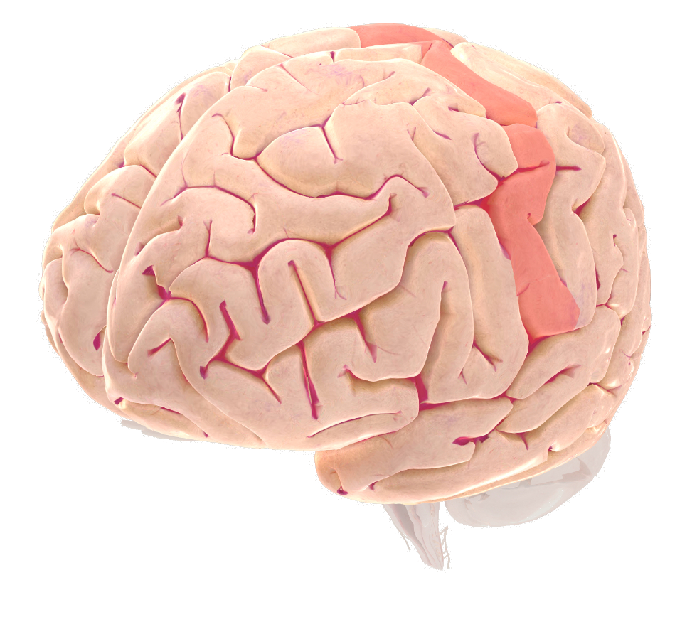

Movement
Back
Front
Copyright © Society for Neuroscience (2017)

Slide 12

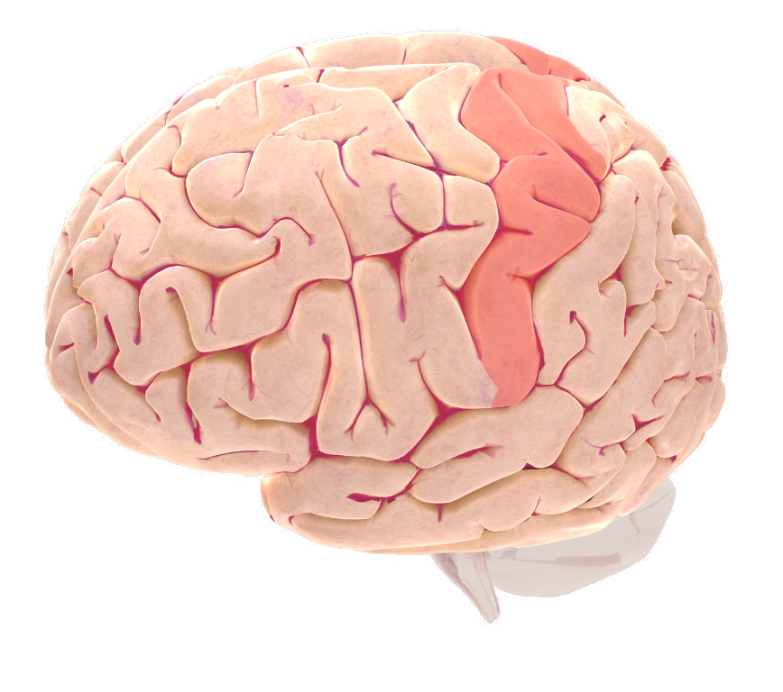
Touch
Front
Back
Copyright © Society for Neuroscience (2017)

Slide 13
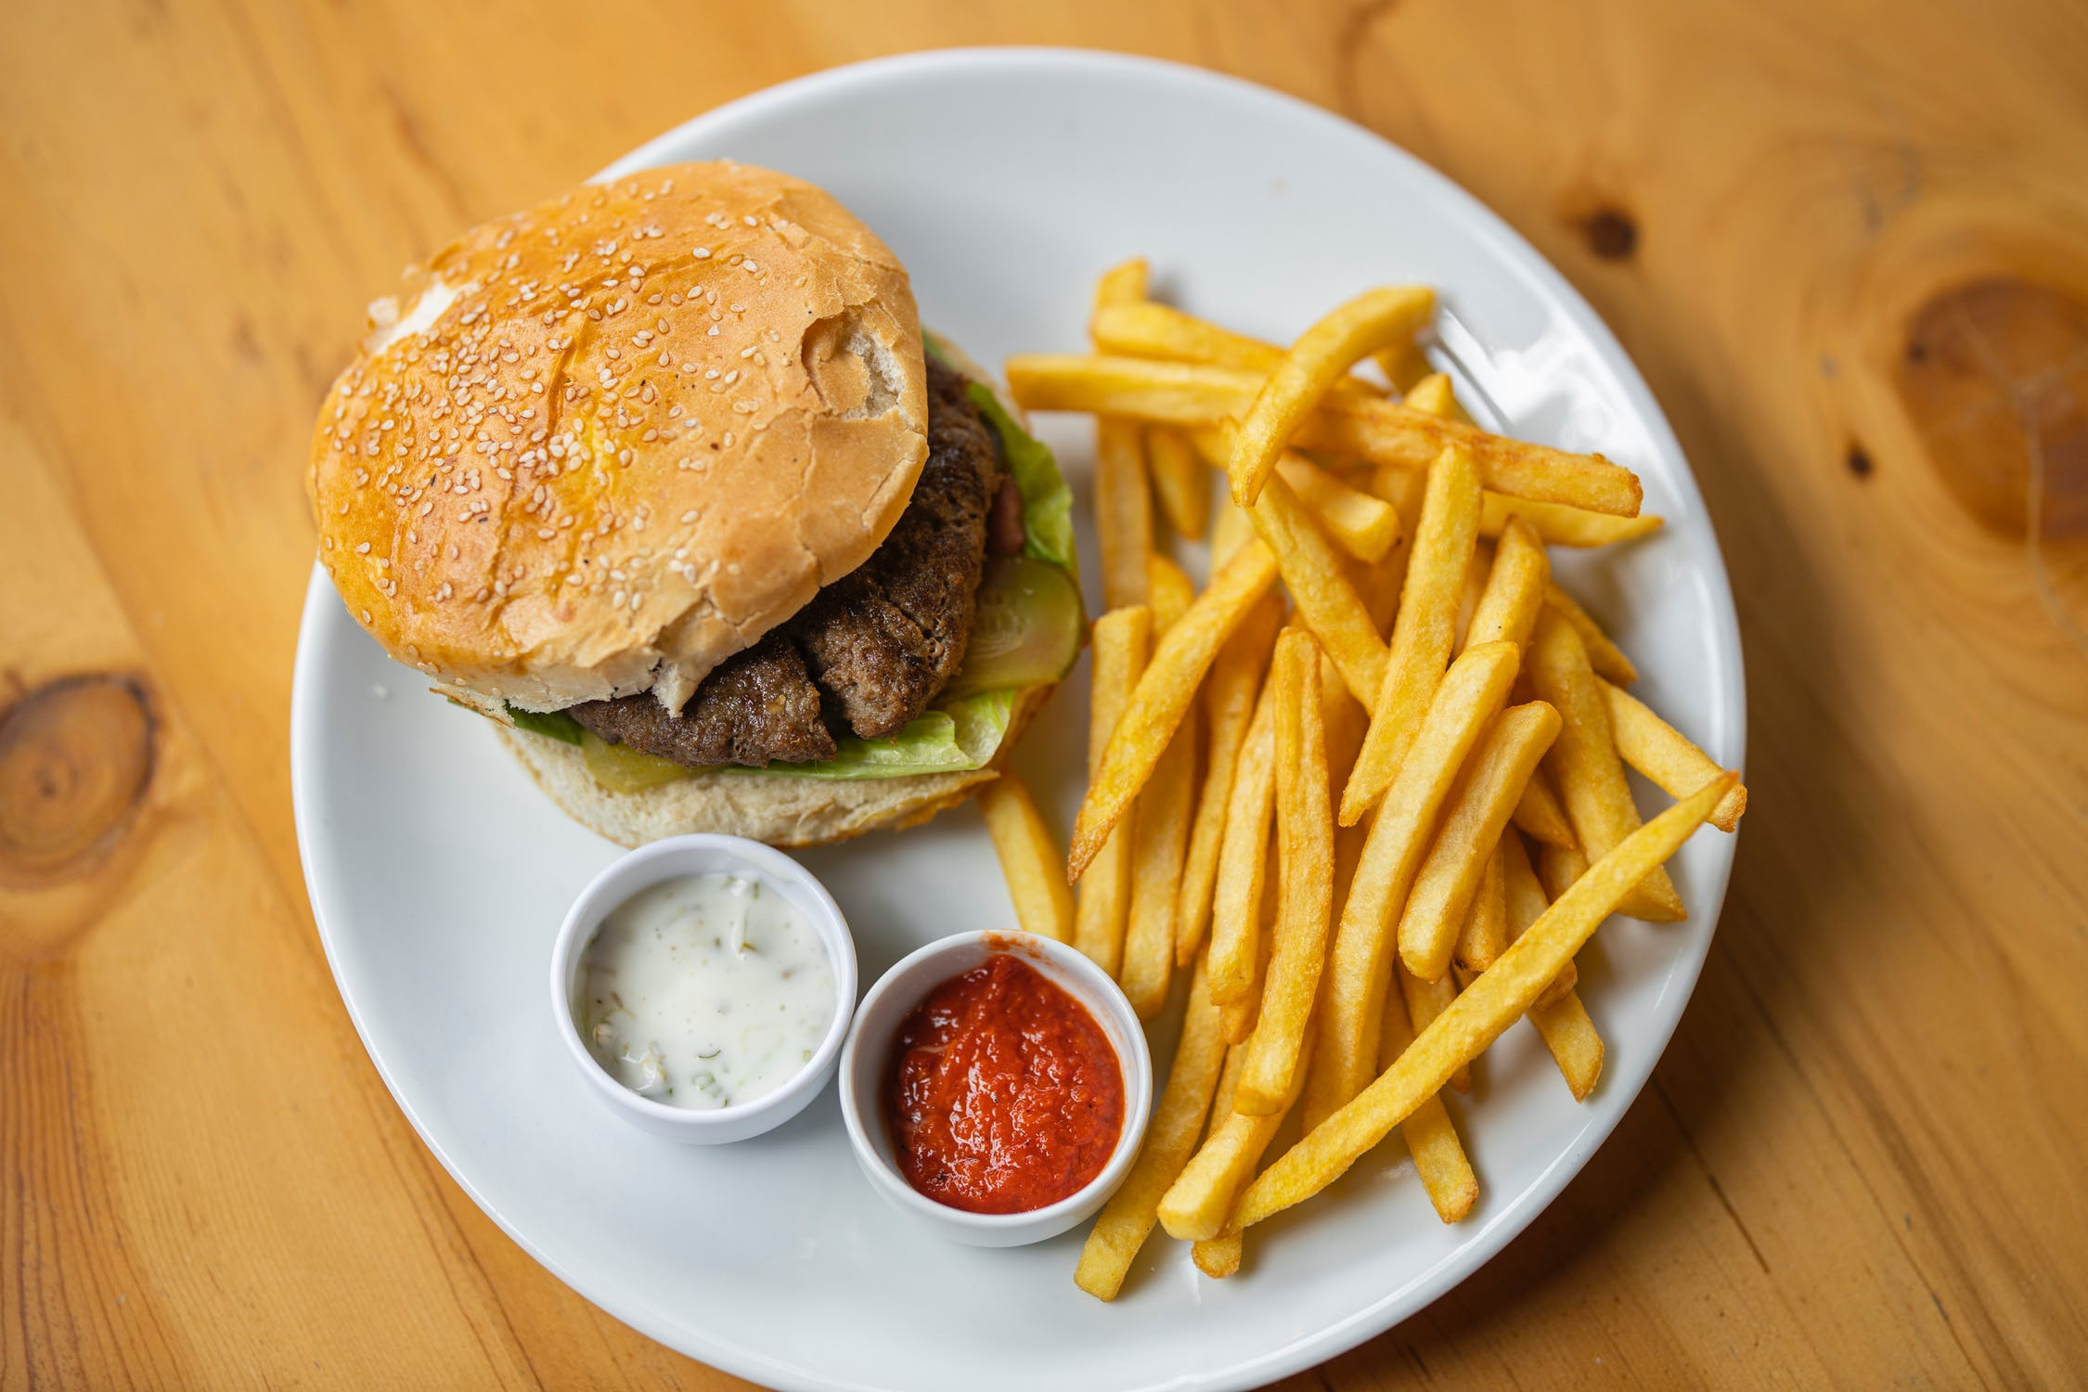

Slide 14
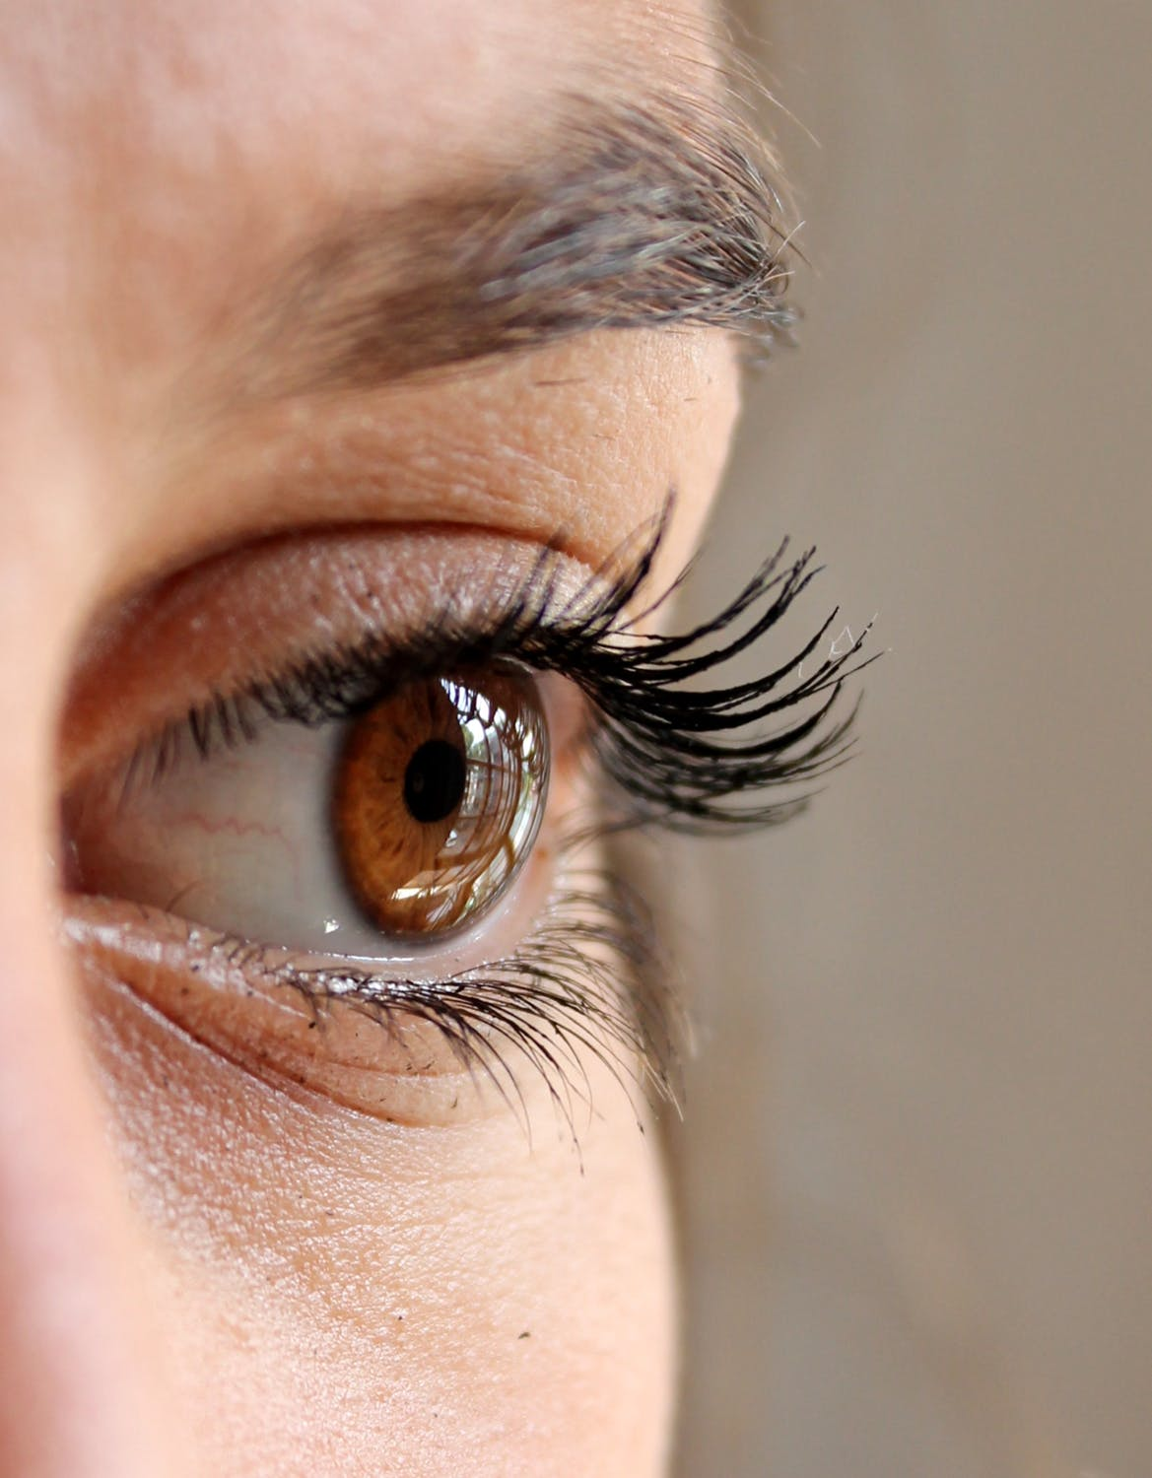

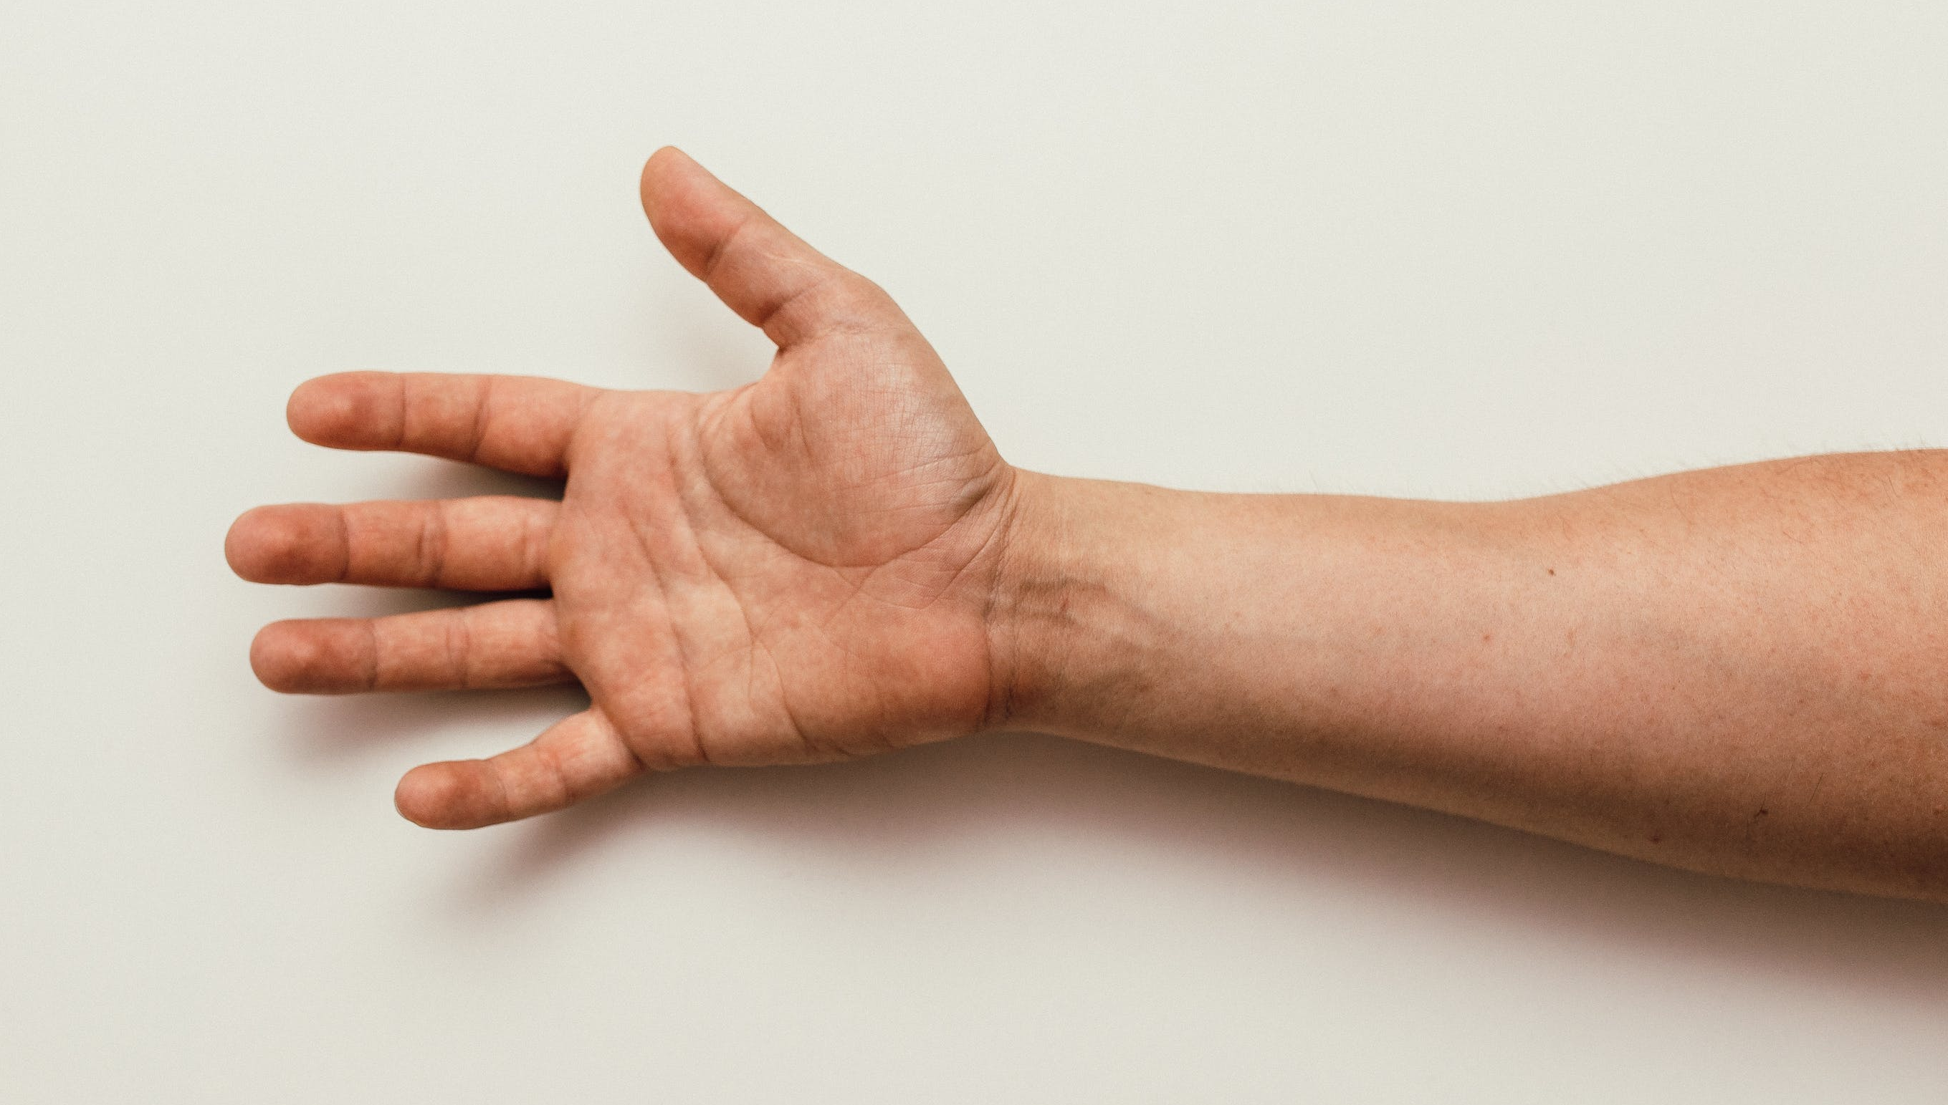
Mmm...yummy

Slide 15
How does the brain send messages?
Electricity
Heat
Cake
Sound

Slide 16



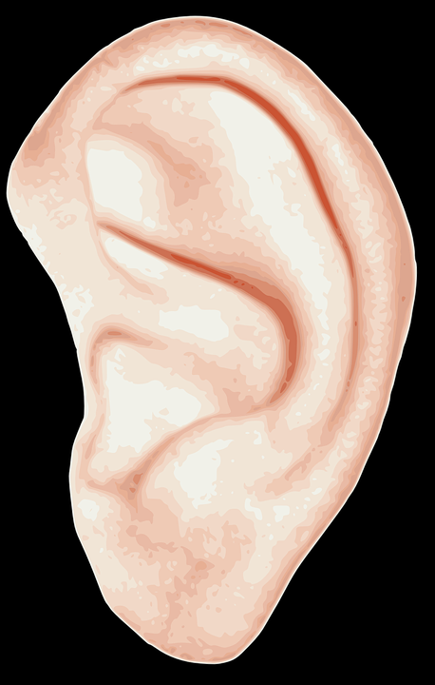


What is electricity?
A form of energy

Slide 17
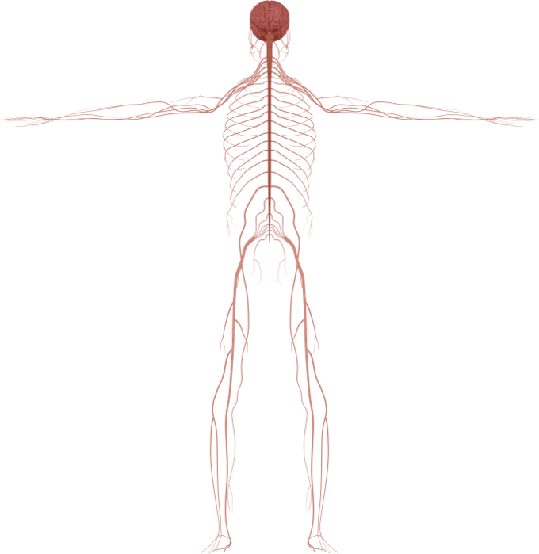
Ulnar nerve stimulation

Slide 18


What is a house made of?
Bricks

Slide 19

Our bodies are made of cells

Slide 20
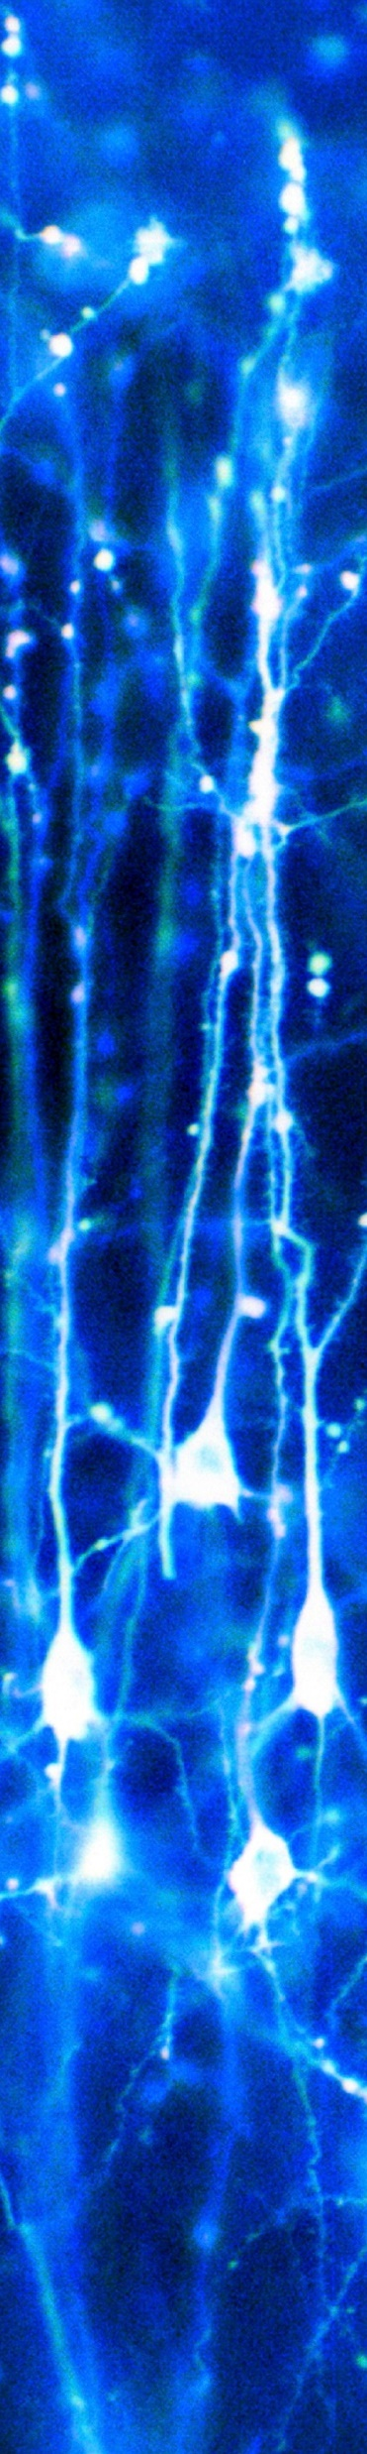
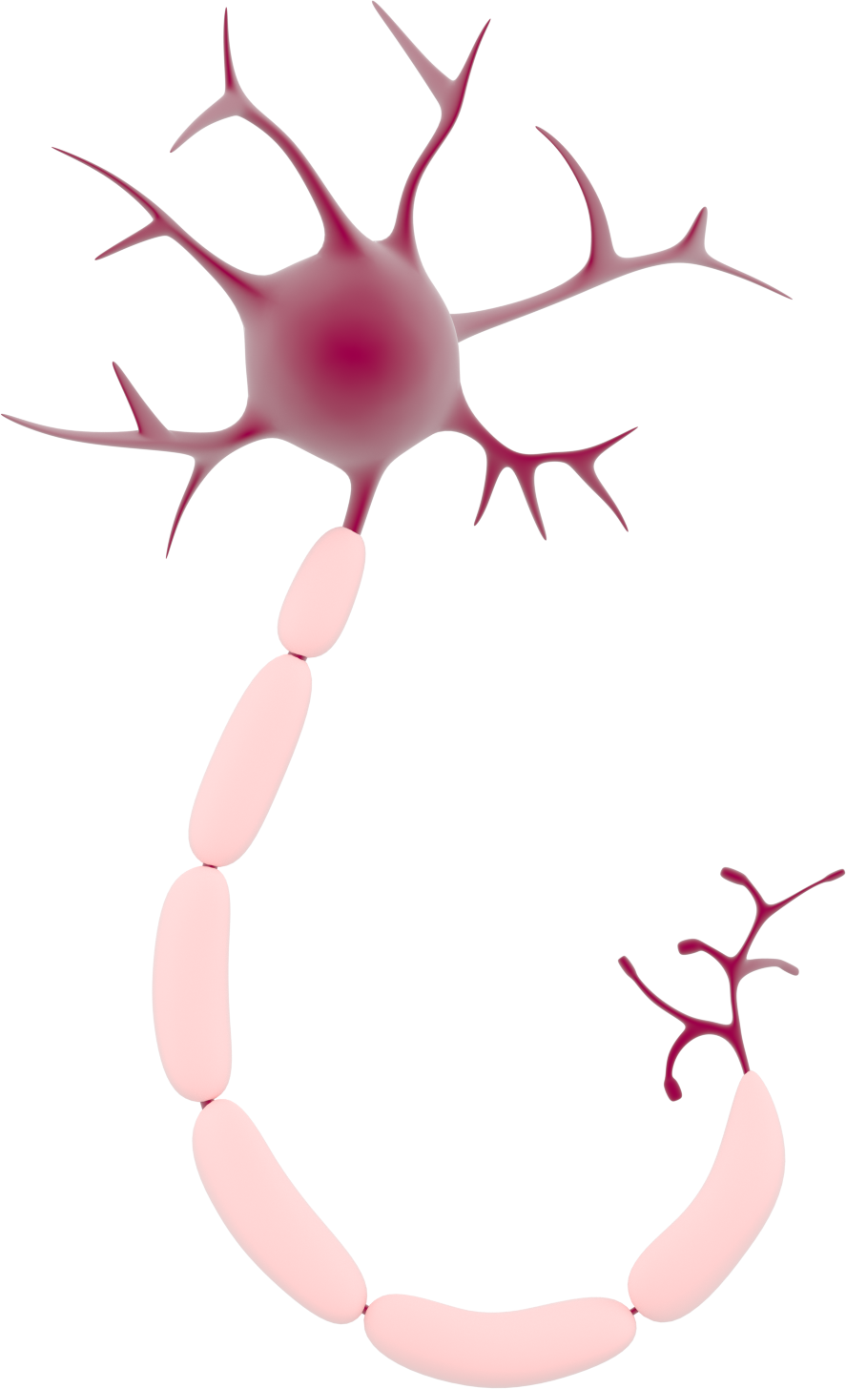
Neuron
'Neurons in the brain' by Dr Jonathan Clarke

Slide 21
How thin is a neuron?
Thinner than a pencil
Thinner than a wire
Thinner than a hair
Thinner than all of those things

Slide 22
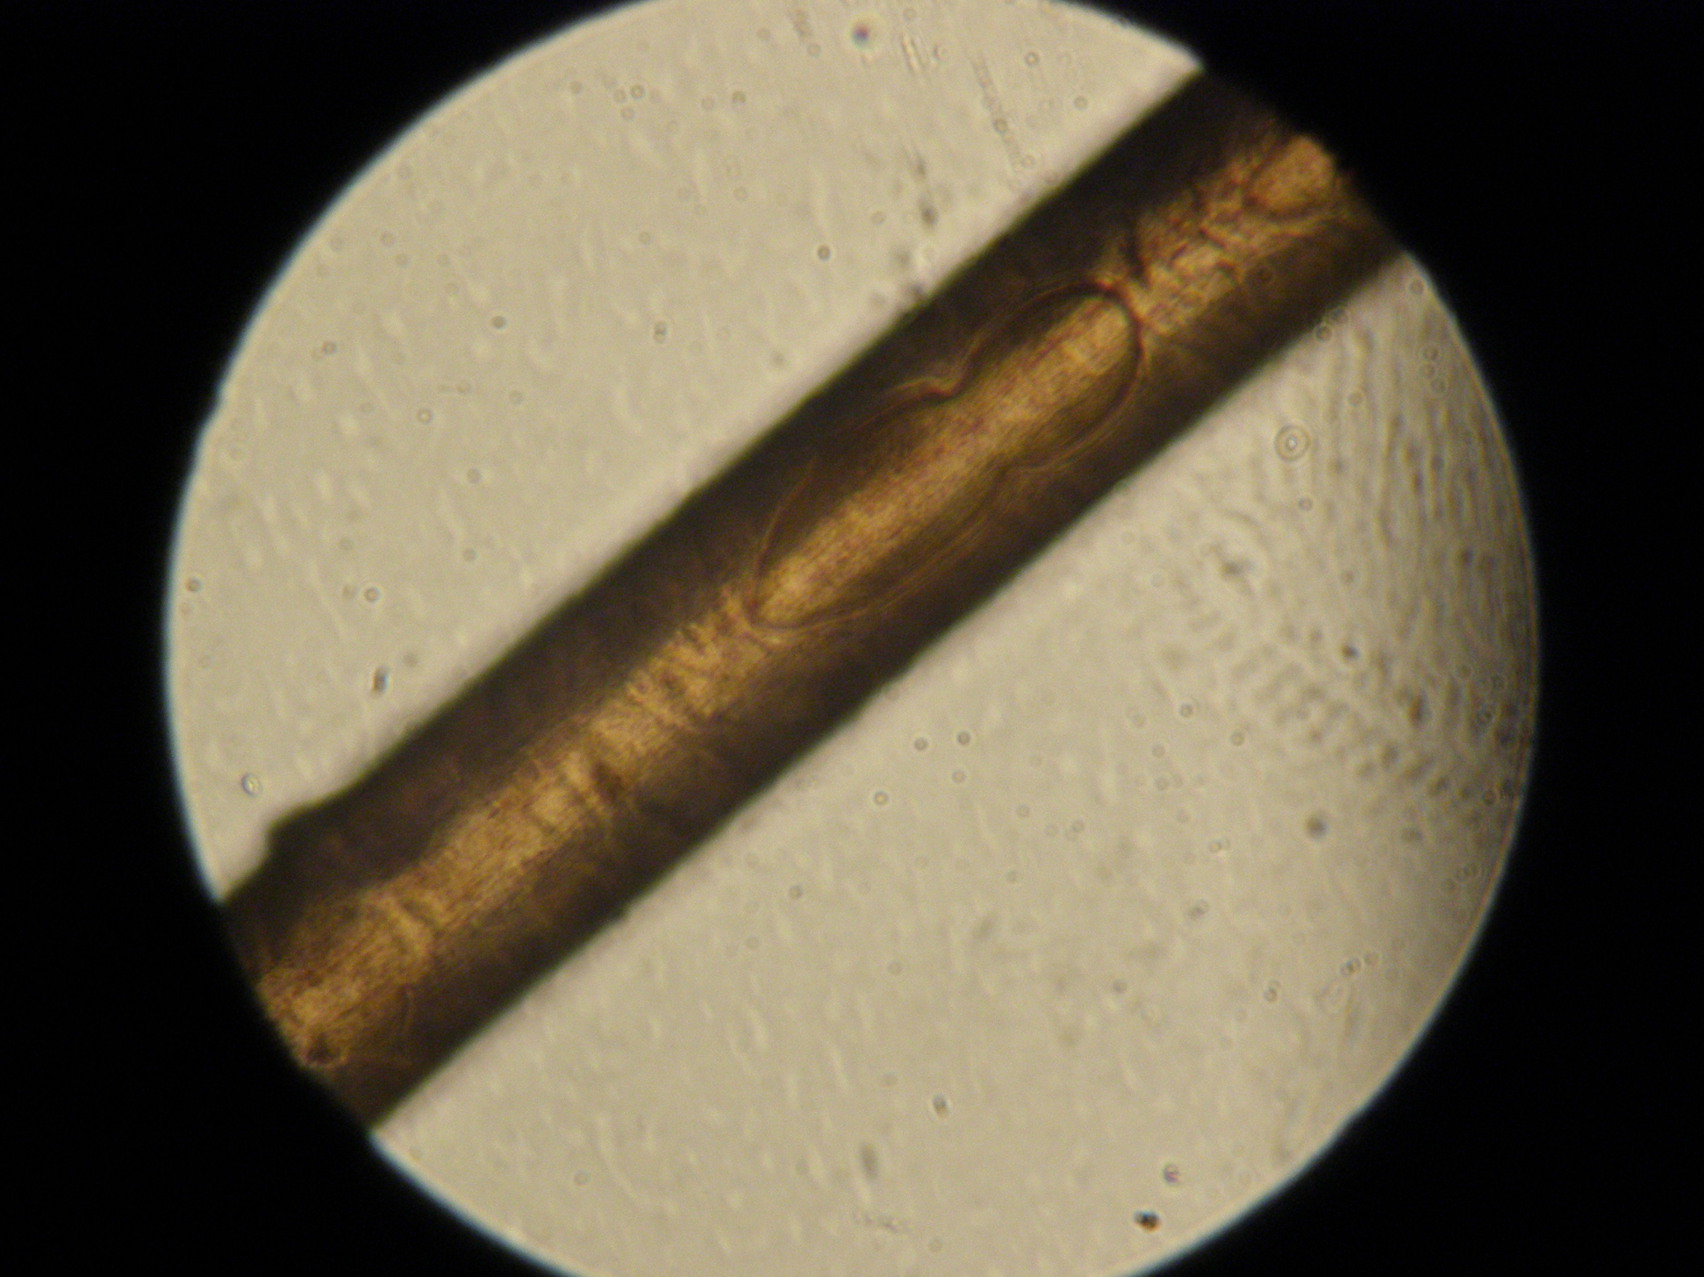
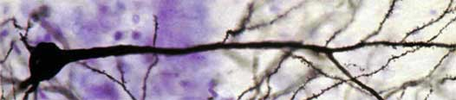
The axon of a neuron is about a third of the thickness of a human hair
axon
Neuron
Human hair
Robert Huber at English Wikibooks / CC BY-SA (https://creativecommons.org/licenses/by-sa/3.0)
Juan de Vojníkov / CC BY-SA (https://creativecommons.org/licenses/by-sa/4.0)

Slide 23
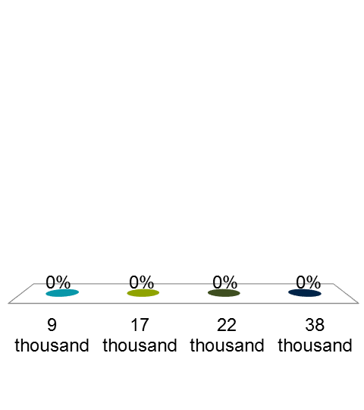
How long is the longest group of neurons in the body?
About 1 cm
About 30cm
About 70 cm
Over 1m

Slide 24
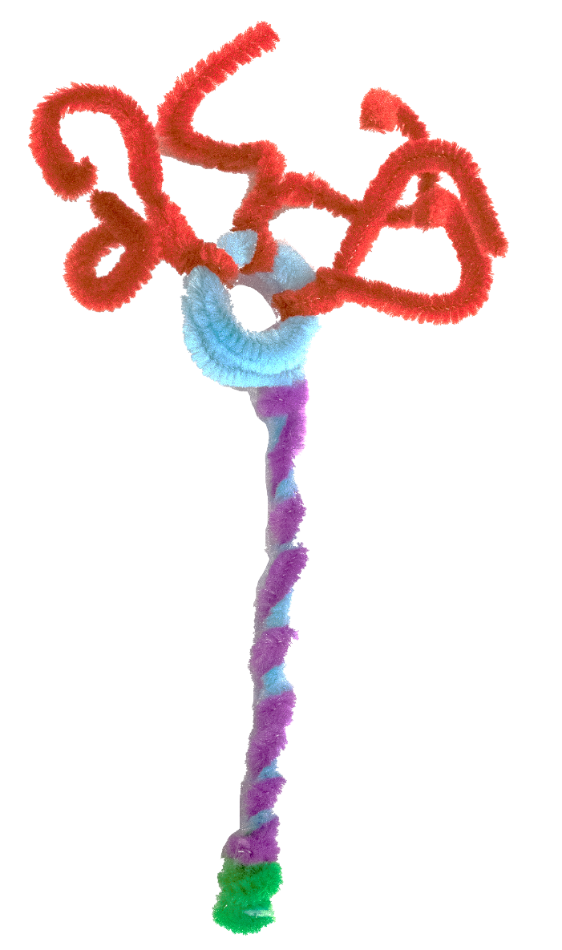
Make a neuron

Slide 25

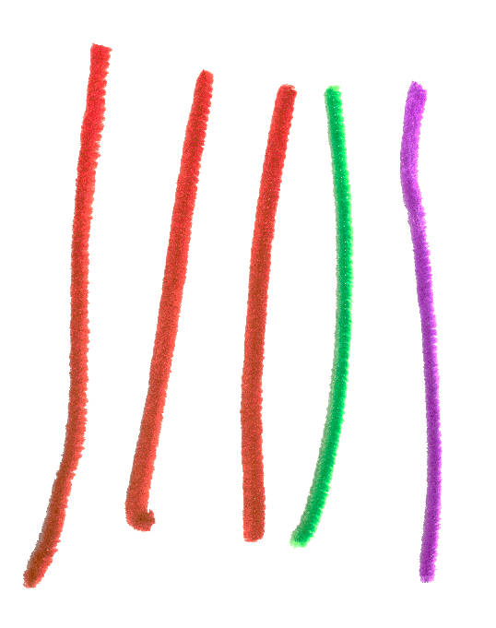
You will need:
1 x long pipe cleaner
5 x short pipe cleaners

Slide 26
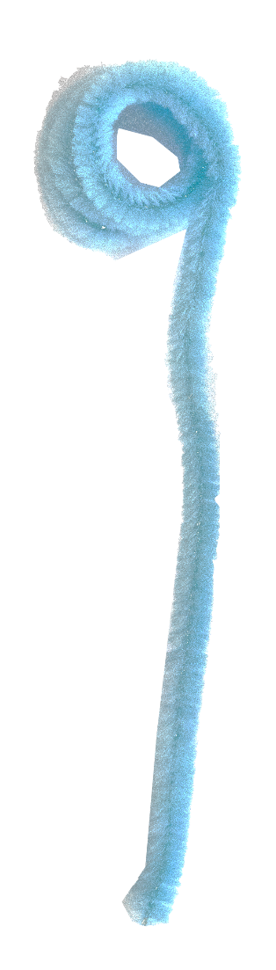
Step 1:
Take one long pipe cleaner & roll half of it into a ball.
Cell body
Axon

Slide 27
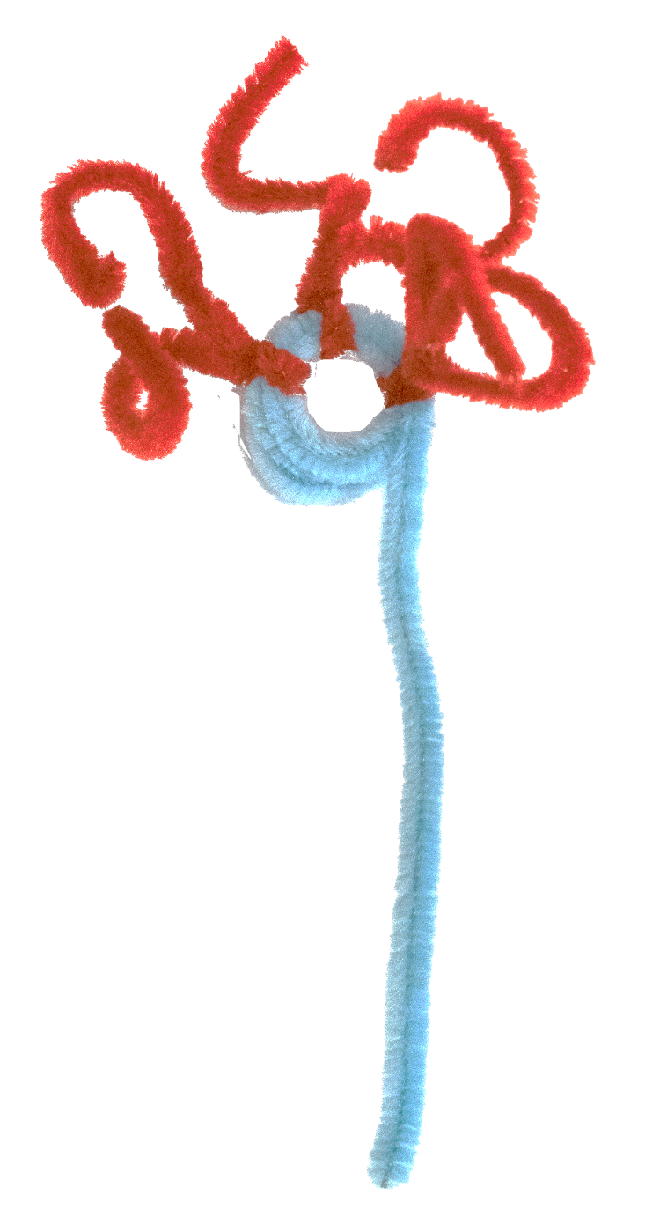
Step 2:
Take short pieces of pipe cleaner and push them into the cell body. Repeat two times.
Dendrites

Slide 28
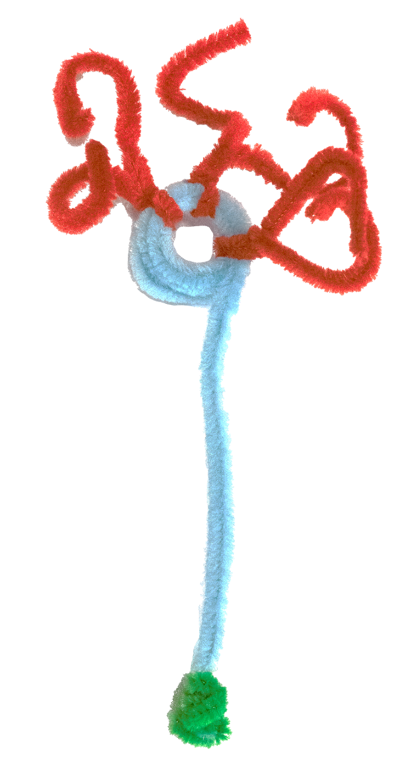
Step 3:
Take another short piece of pipe cleaner and wrap it around the end of the long pipe cleaner (axon).
2
Axon terminal

Slide 29

Step 4:
Take the last short piece of pipe cleaner and wrap it along the axon.
2
Myelin
sheath

Slide 30
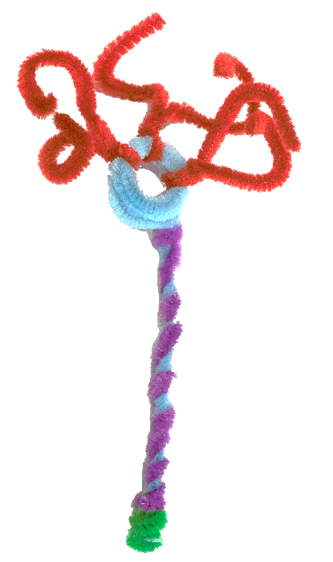
Step 1:
Step 2: ​
Step 3:
Step 4:

Slide 31
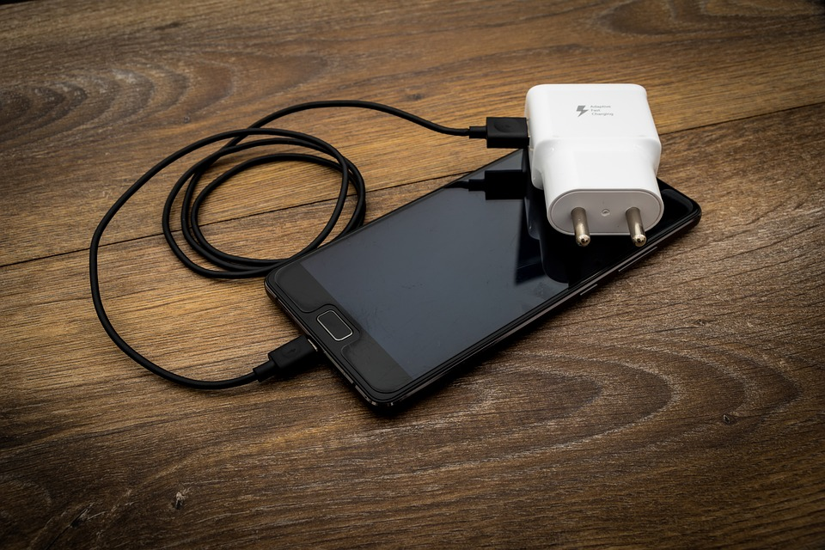
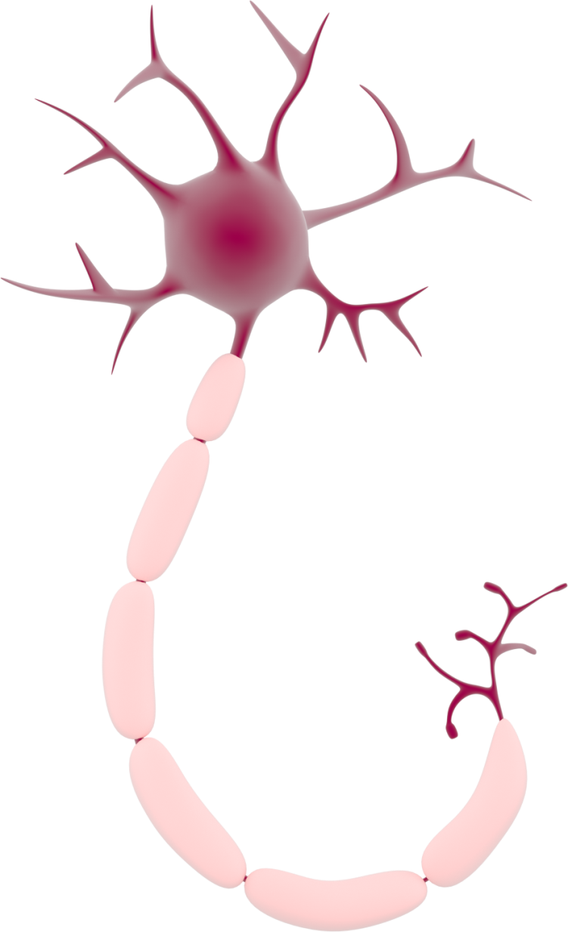
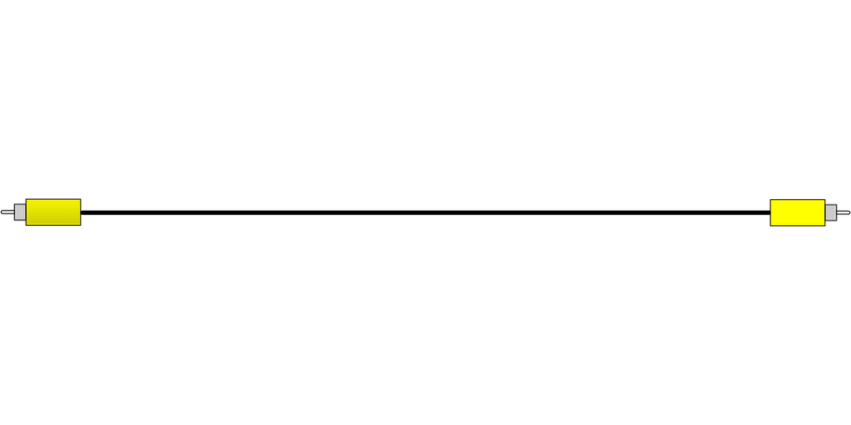
How does the message travel through one neuron?
Electricity

Slide 32
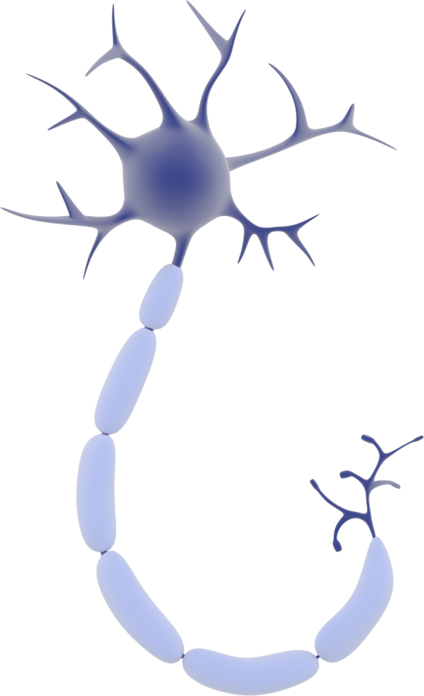



How do neurons talk?
Signal received
Synapse

Slide 33
How do neurons talk?
Chemicals
Signal received
Synapse

Slide 34
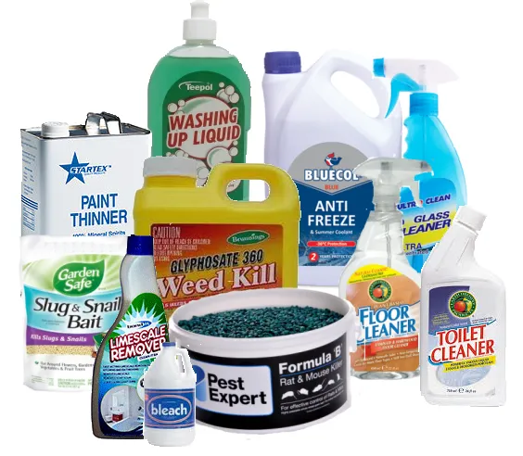
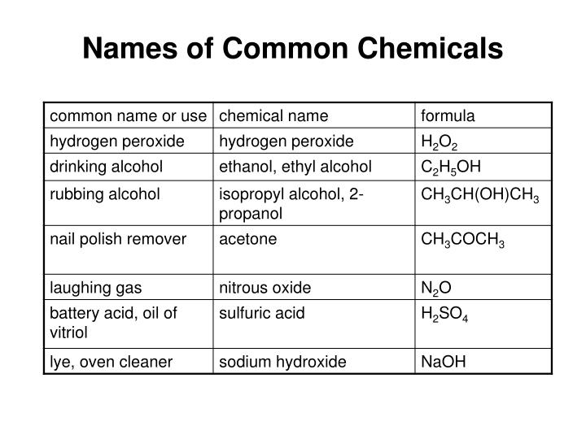

Slide 35

Neuron race

